Slide 1
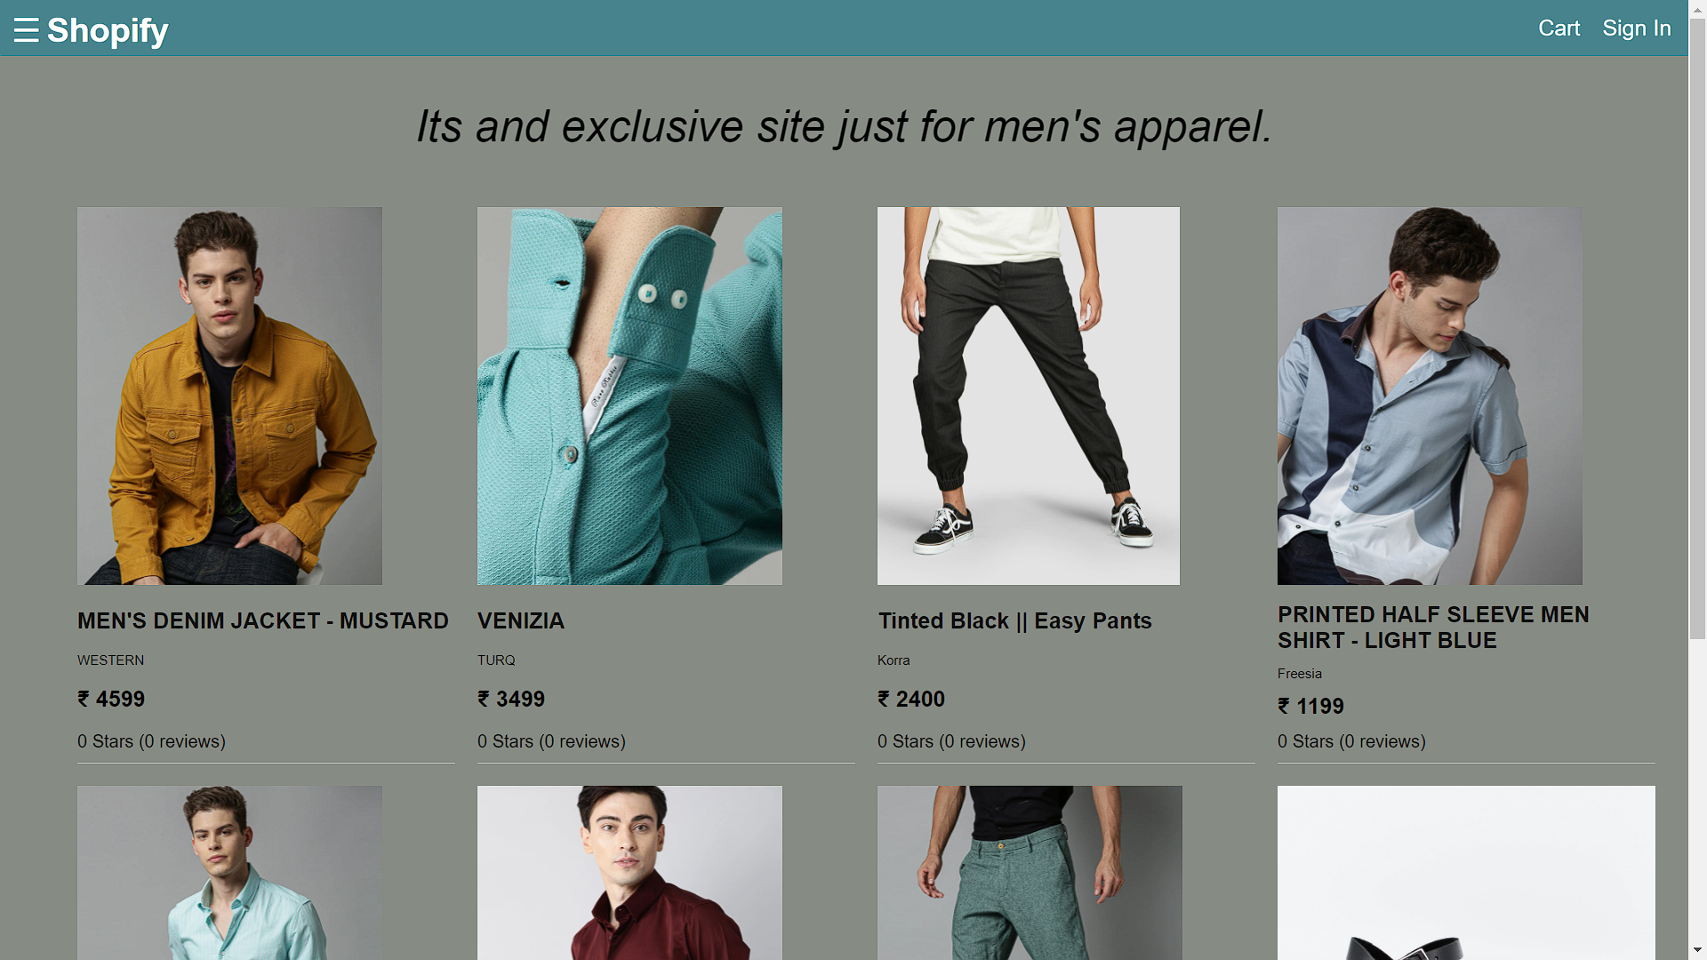
E-Commerce Project - Shopify
Course Coordinator – Mr. Manoj Wariya Sir
Under Guidance of – Mr. Saurav Tripathi Sir
Team Name – MAVS
Ajay Singh(2019CA46)
Shivam Sharma(2019CA58)
Mohd Azeem(2019CA83)
Vishwam Singh(2019CA55)

Slide 2
INTRODUCTION
In preparation of our Project, We had to take the help and guidance of some respected persons, who deserve our deepest gratitude. As the completion of this Project gave us much pleasure, We would like to show our gratitude Mr. Manoj Wariya Sir, Course Coordinator, Motilal Nehru National Institute of Technology for giving us quick guidelines for Project through numerous consultations, Assignments and Lectures. We would also like to expand our gratitude to all those who have directly and indirectly guided me in writing this Project.
In addition, a thank you to Mr. Saurav Tripathi Sir, Mr. Ataussamad and Mr. Sailendra Kumar Singh who introduced us to the Methodology of work, and whose passion for the “underlying structures” had lasting effect.

Slide 3
Technologies Used (Front-End):
(i) ReactJs - It combines Javascript and HTML/CSS into one file to provide excellent cross platform support and UI focused design. Templating is easy as components can be rendered once and re-used thereby increasing the overall productivity and modularity of the project. Rich development tools make debugging easier and development faster.
(ii) ReduxJs - Redux is an open-source JavaScript library for managing and centralizing application state. It is most commonly used with libraries such as React or Angular for building user interfaces. Similar to Facebook's Flux architecture. It can maintain a store to store the data globally for the running web-application. It enhances the usage of hooks in react. States can be authenticated before updation or retrieval.

Slide 4
Technologies Used (Front-End):
(iii) JS-Cookie - To store the information of the current user in the browser cookie to give support for cart items and session variables.
(iv) Babel : Babel is a free and open-source JavaScript trans-compiler that is mainly used to convert ECMAScript 2015+ code into a backwards compatible version of JavaScript that can be run by older JavaScript engines. Babel is a popular tool for using the newest features of the JavaScript programming language. To convert JS6 into JS5 and render JSX elements.
(v) React-Router-Dom : React Router DOM enables you to implement dynamic routing in a web app. Unlike the traditional routing architecture in which the routing is handled in a configuration outside of a running app, React Router DOM facilitates component-based routing according to the needs of the app and platform. For declaring routes and paths in the front-end.

Slide 5
Technologies Used (Back-End):
(i) NodeJs - Node.js is an open-source, cross-platform, back-end JavaScript runtime environment that runs on the V8 engine and executes JavaScript code outside a web browser. Since NodeJs is an asynchronous and event driven javascript runtime environment, it provides faster execution of codes and massive speed gains which enables it to handle multiple connections single handedly.
(ii) ExpressJs - Express.js, or simply Express, is a back-end web application framework for Node.js, released as free and open-source software under the MIT License. It is designed for building web applications and APIs. It has been called the de facto standard server framework for Node.js. Express is a minimal and flexible Node.js web application framework that provides a robust set of features for web and mobile applications.

Slide 6
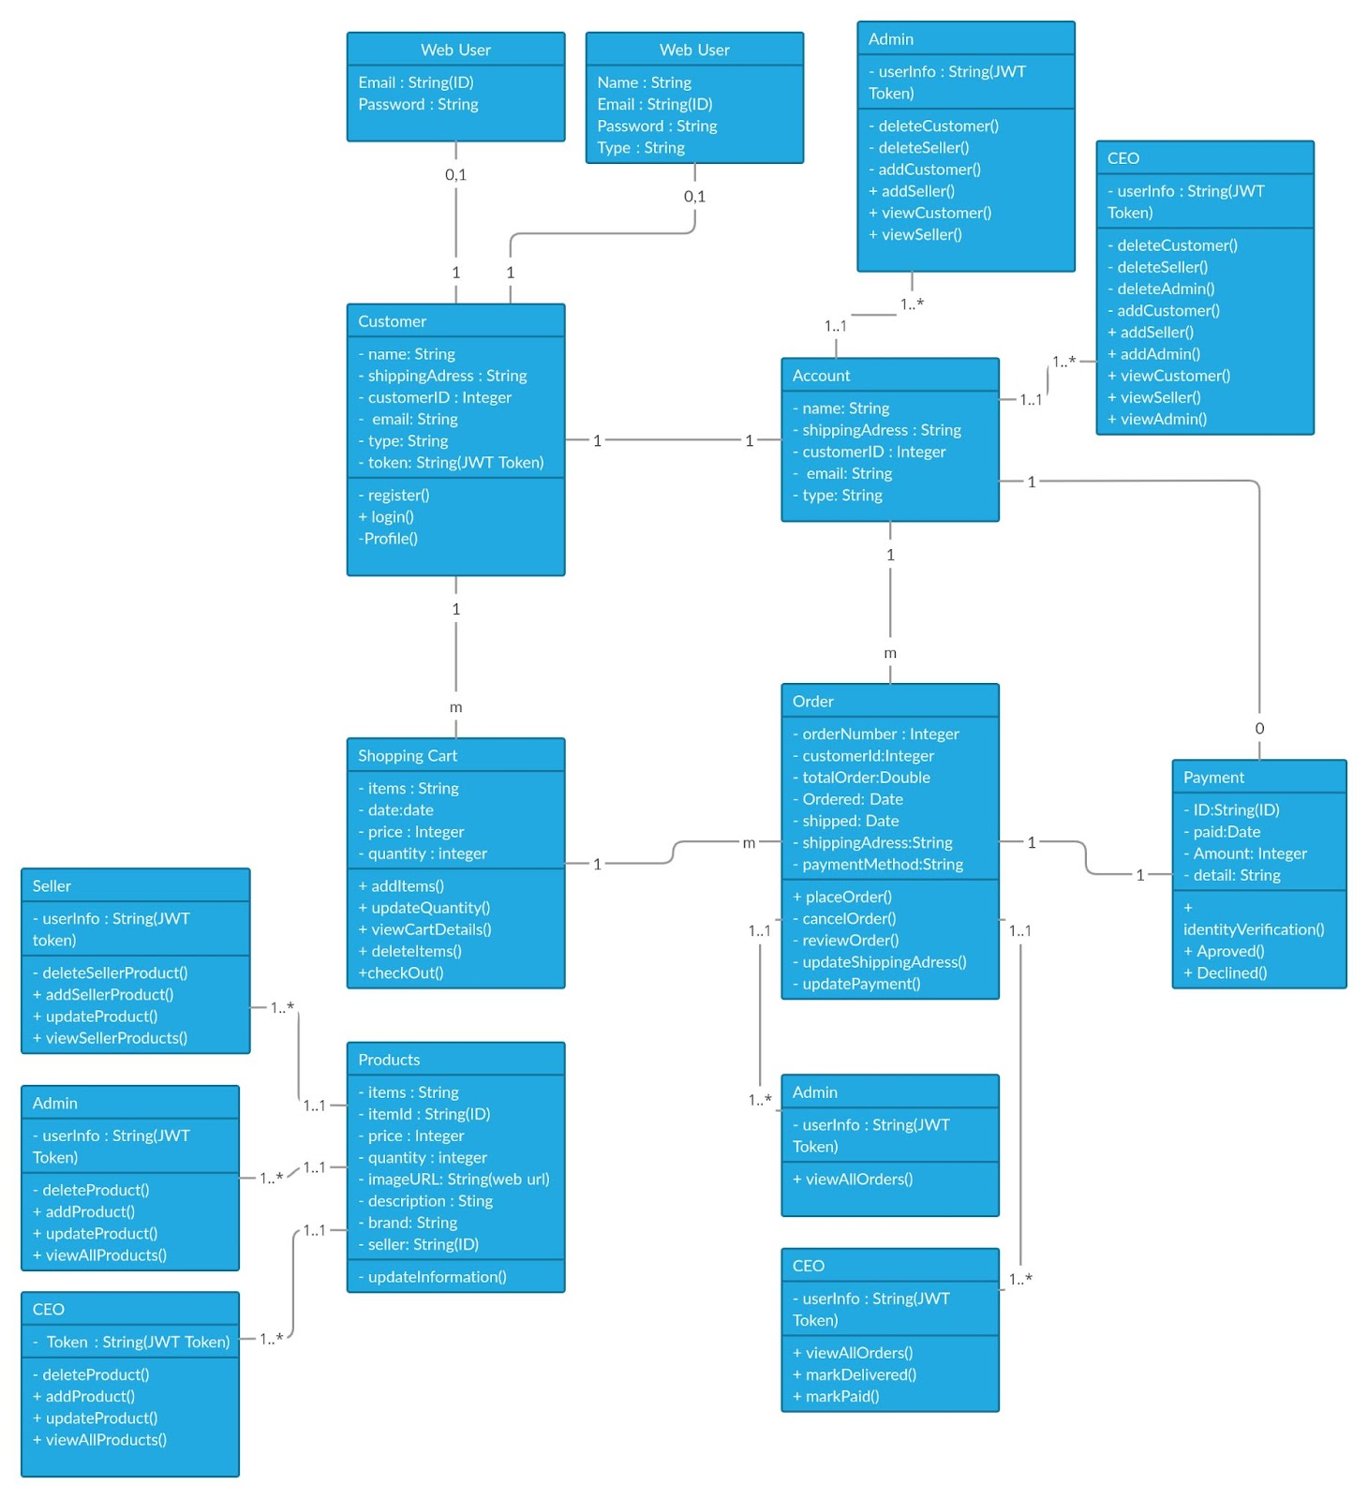
UMLCLASS DIAGRAM

Slide 7
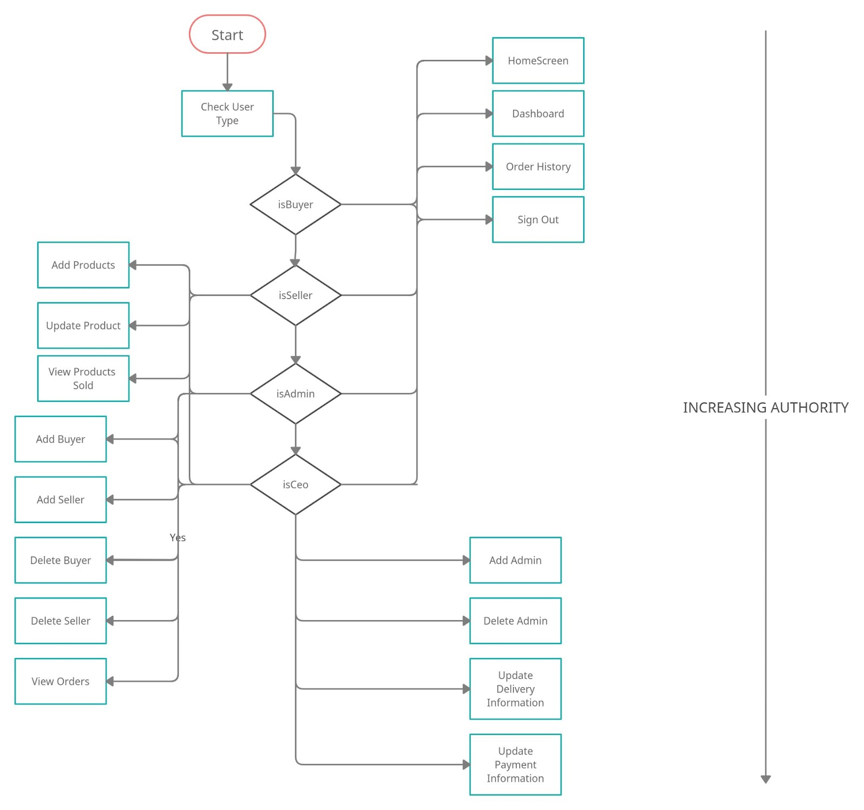
Flow-Chart For Users Operation (Event Driven)

Slide 8
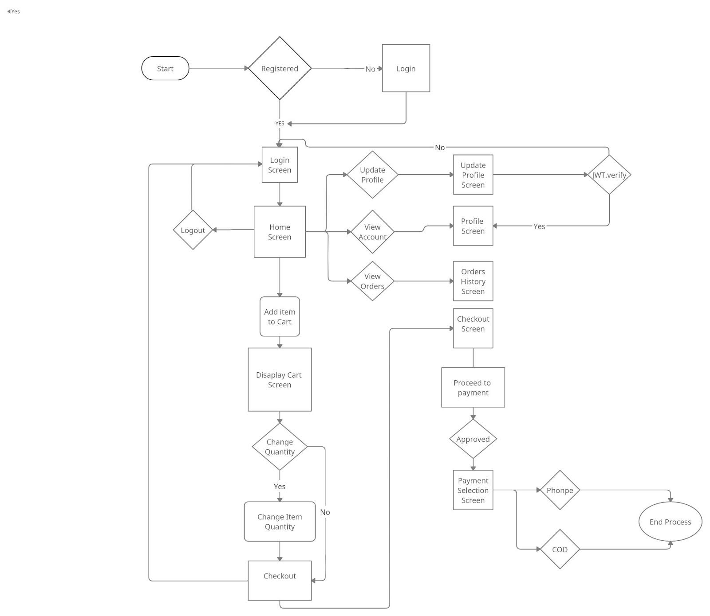
FlowChart for placing order and payment

Slide 9
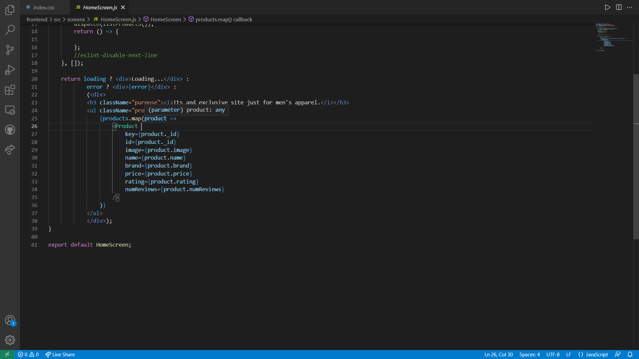
HomeScreen Code

Slide 10
HomeScreen ScreenShot

Slide 11
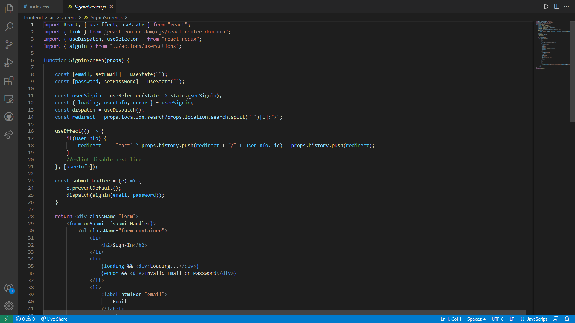
SignInScreen Code

Slide 12
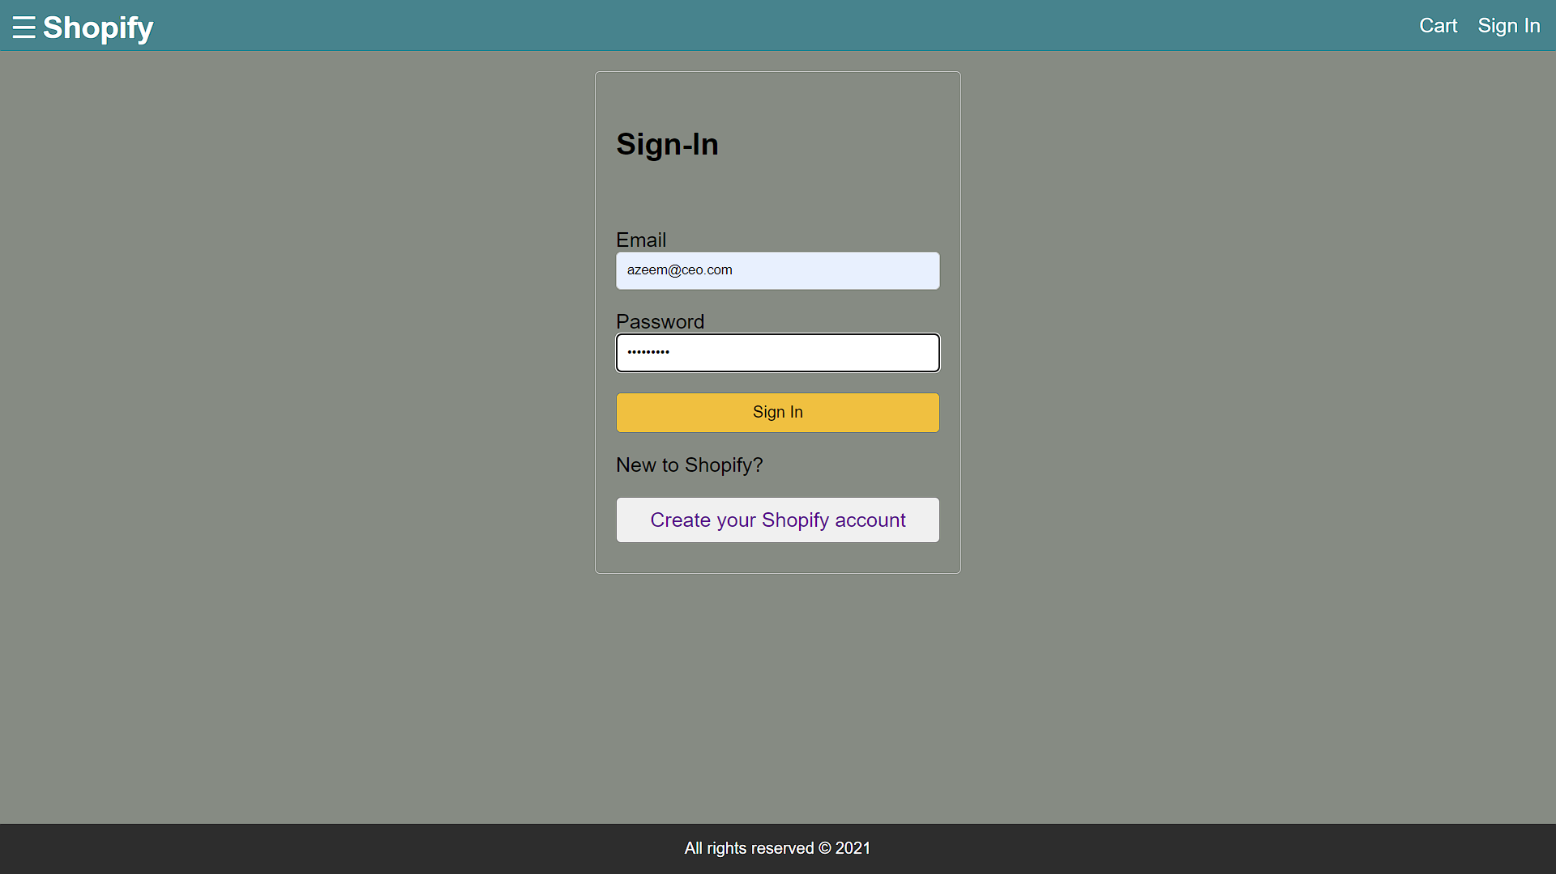
SignInScreen ScreenShot (USER - CEO)

Slide 13

SignInScreen Success ScreenShot (USER - CEO)

Slide 14
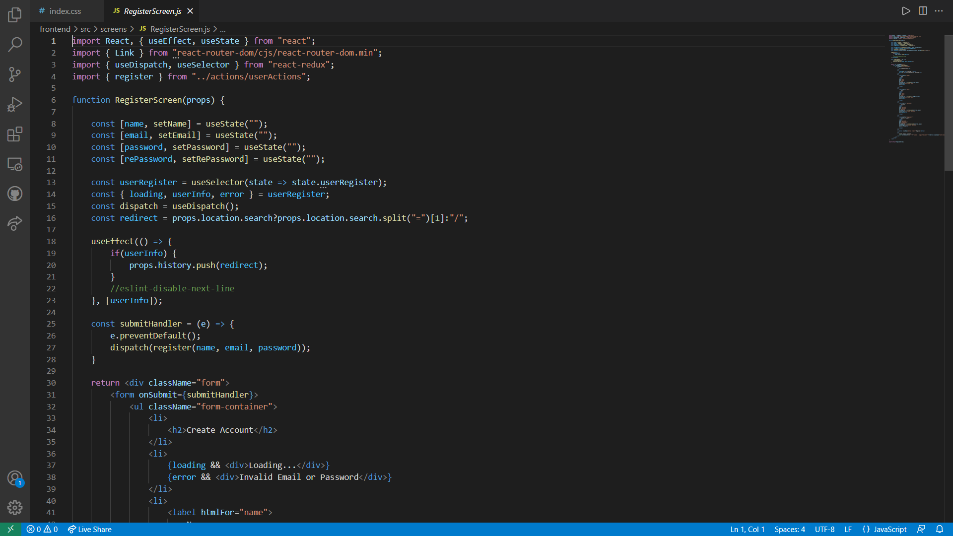
RegisterScreen Code

Slide 15
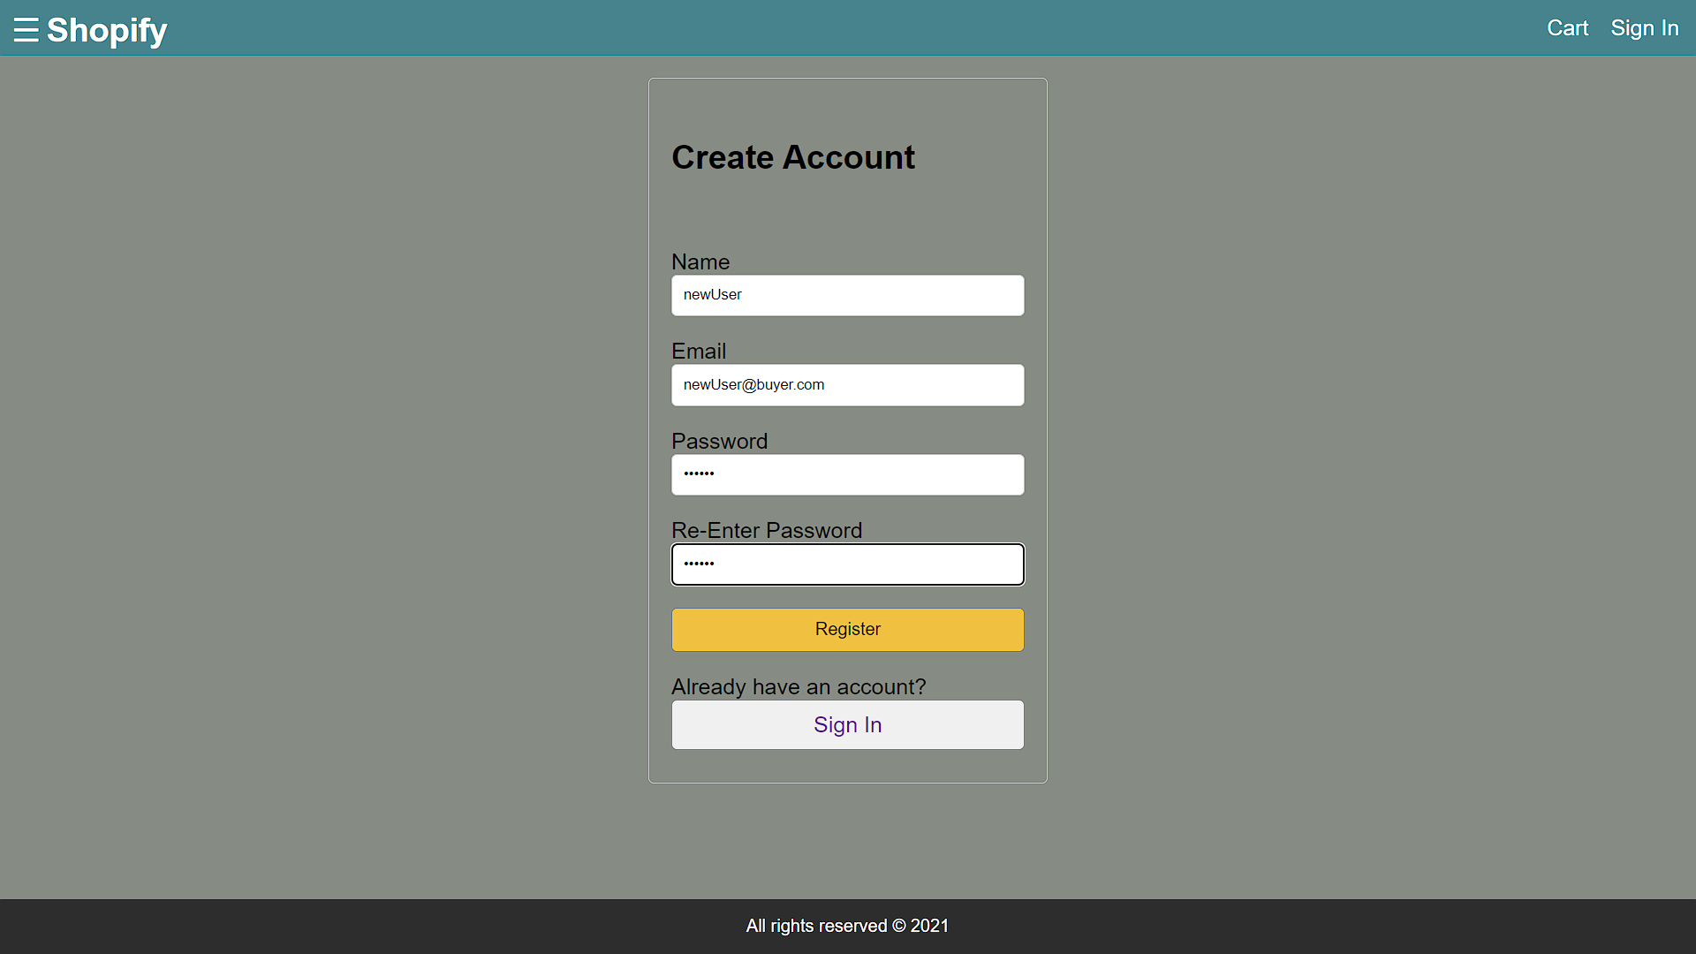
New User RegisterScreen ScreenShot

Slide 16

New User RegisterScreen Success ScreenShot

Slide 17
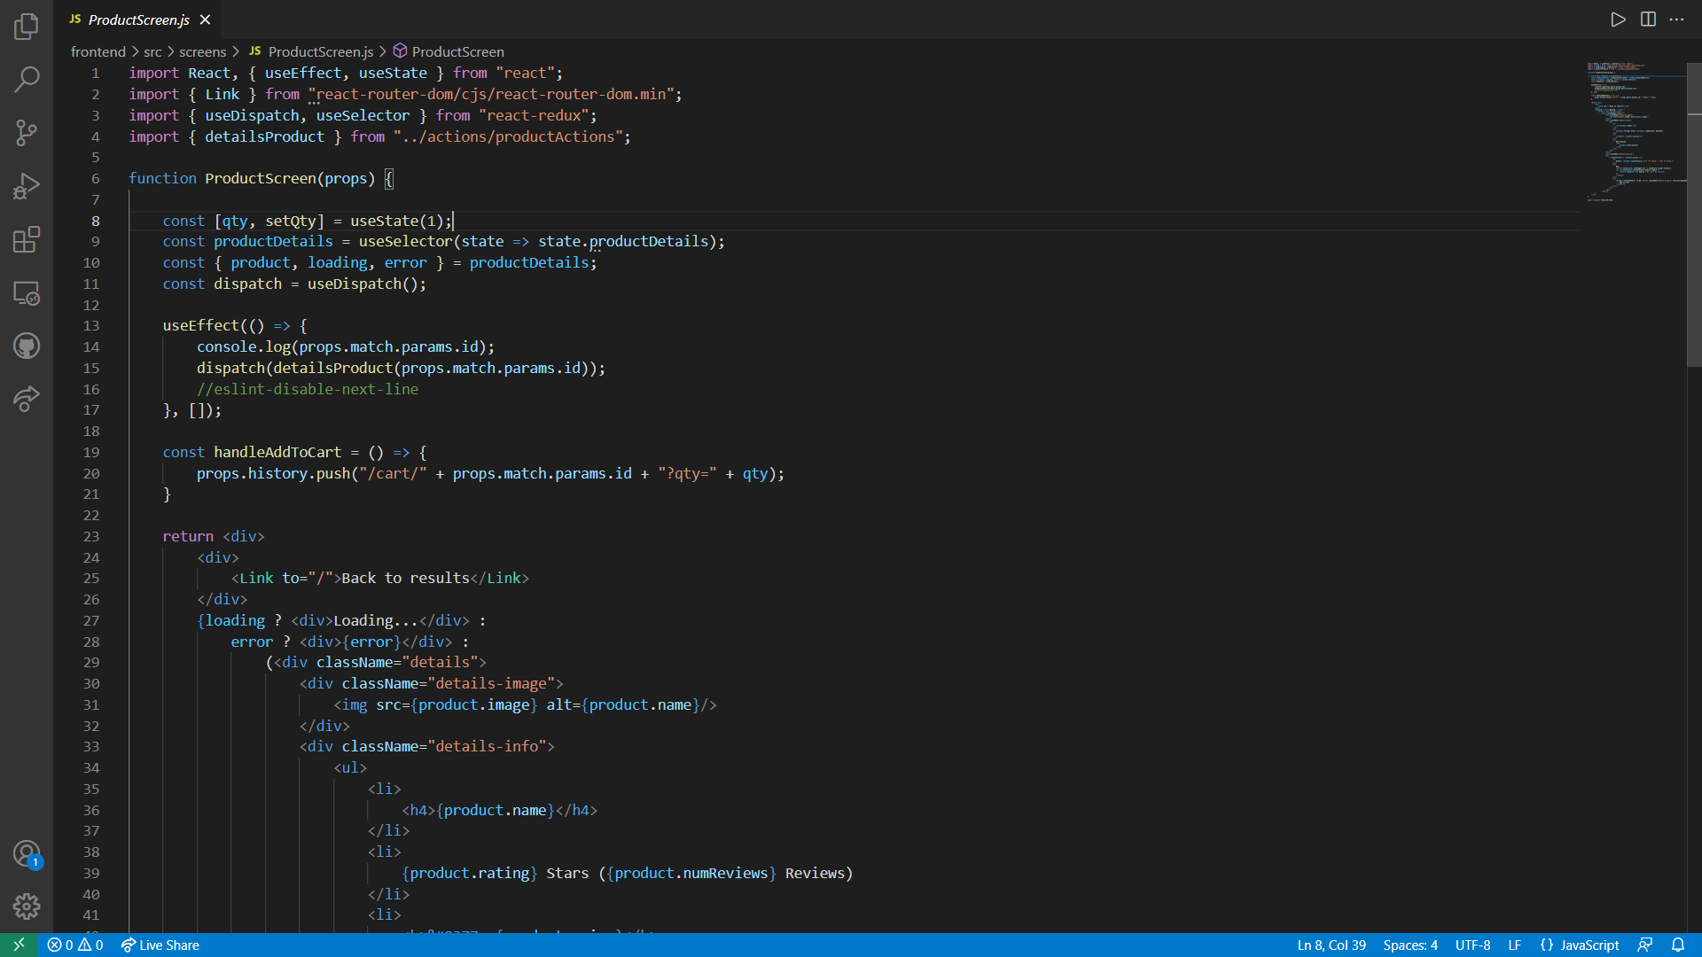
ProductScreen Code

Slide 18
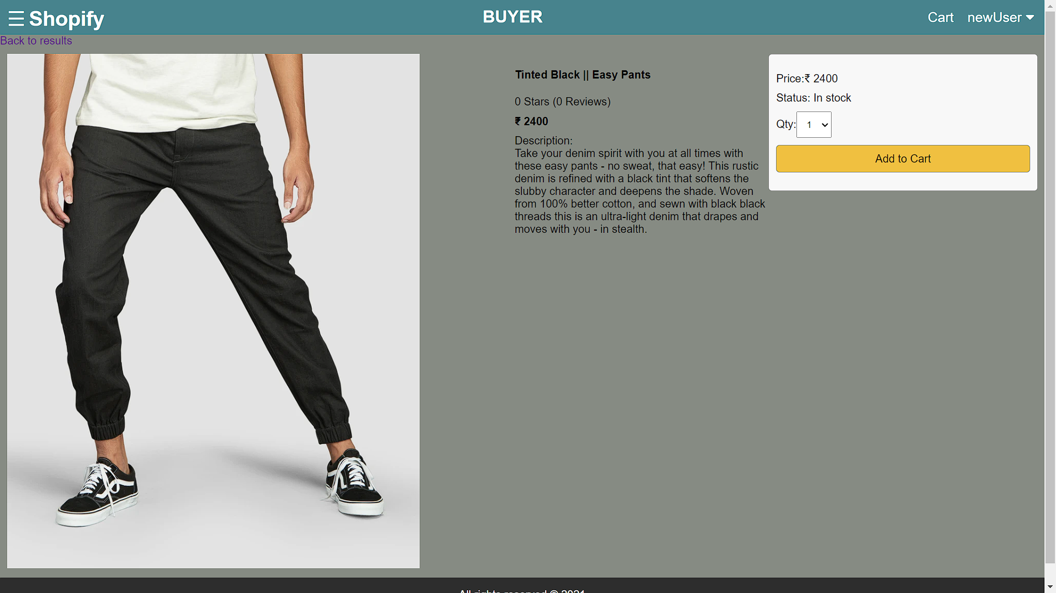
ProductScreen ScreenShot

Slide 19
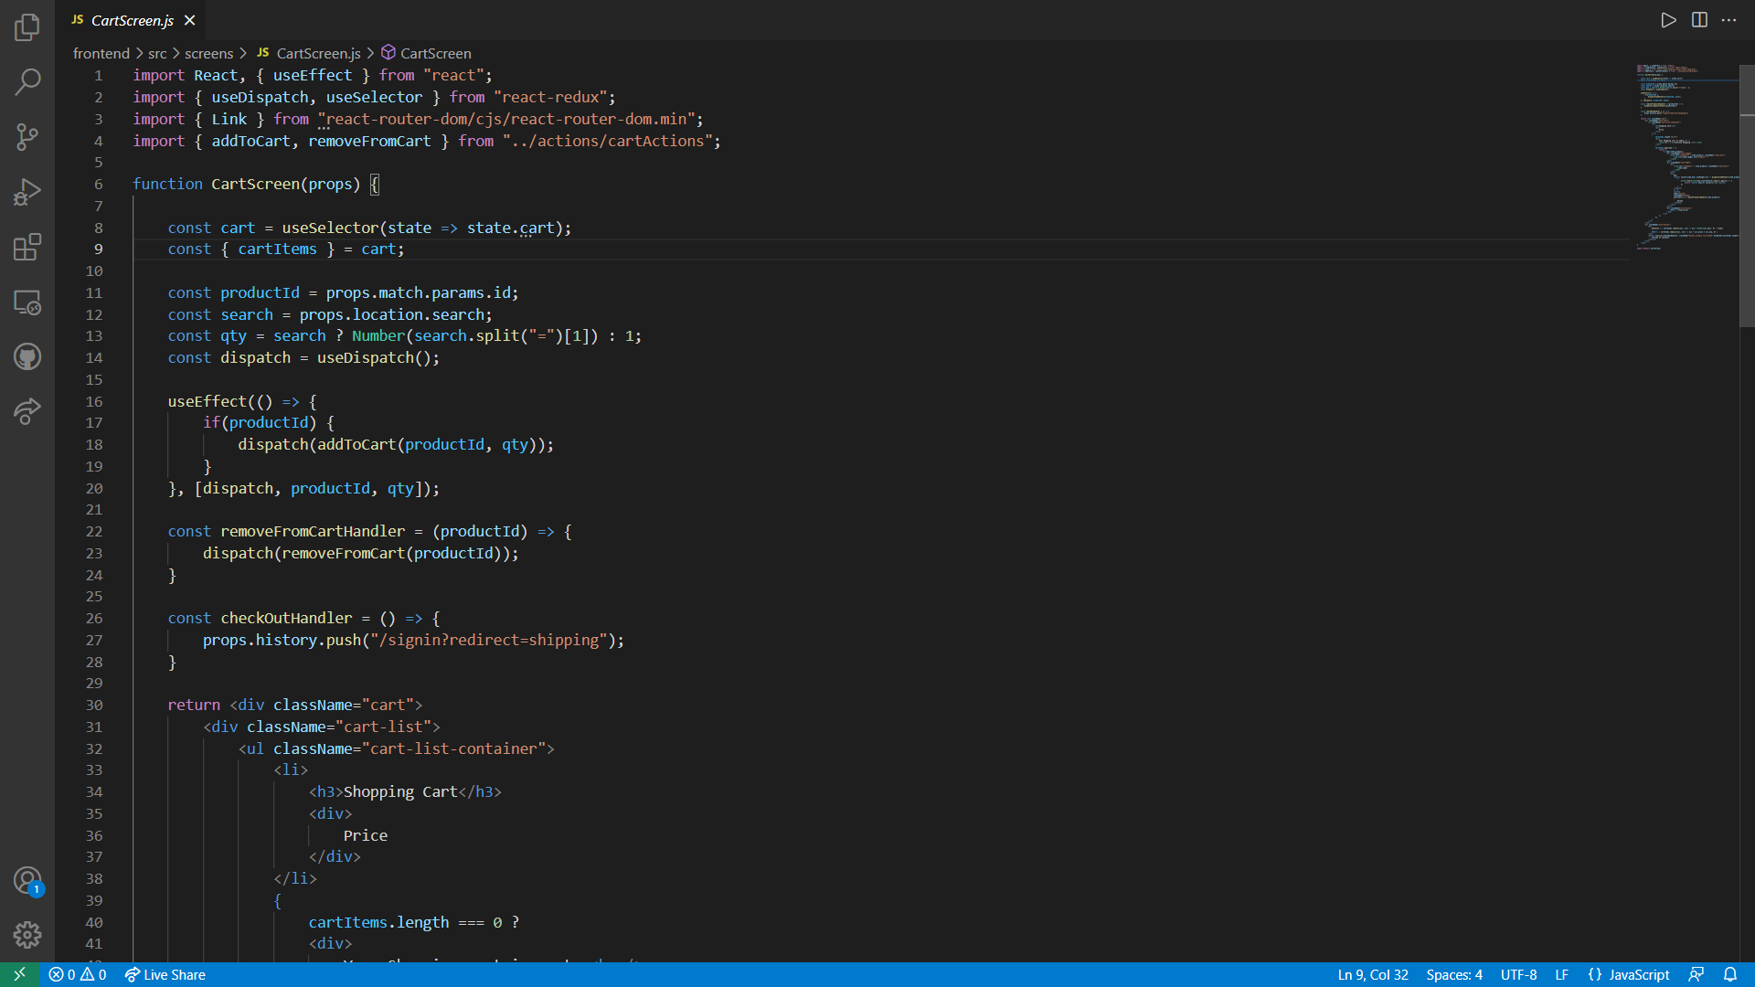
CartScreen Code

Slide 20
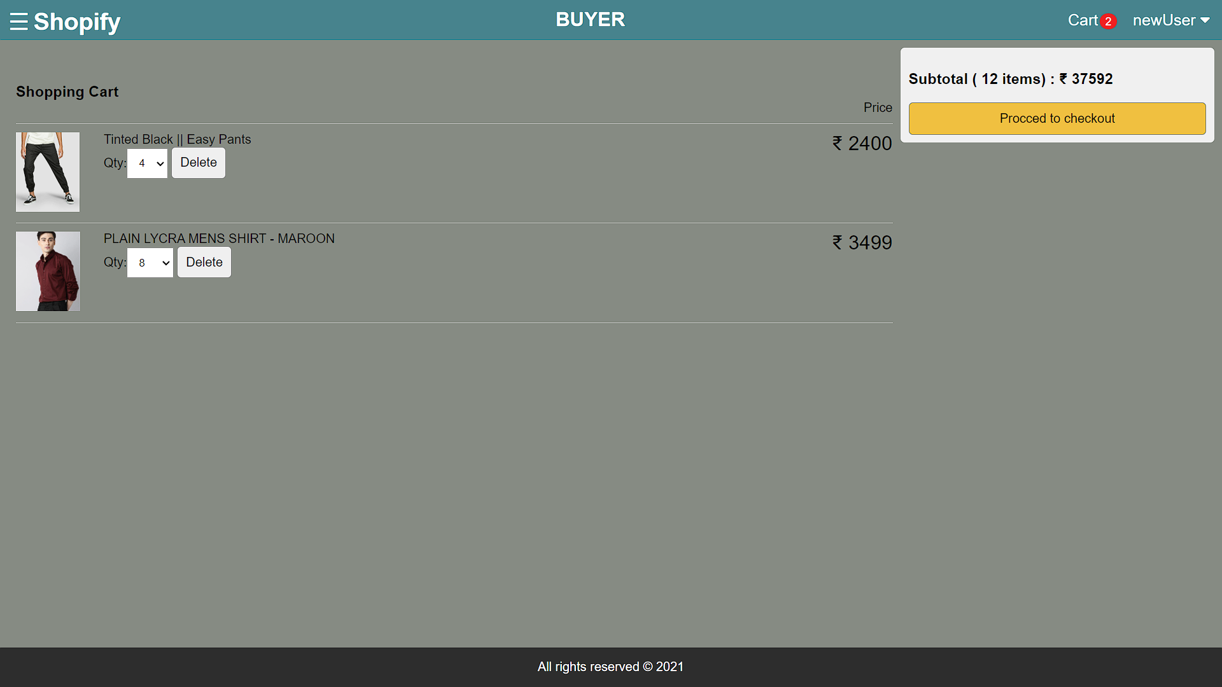
CartScreen ScreenShot

Slide 21
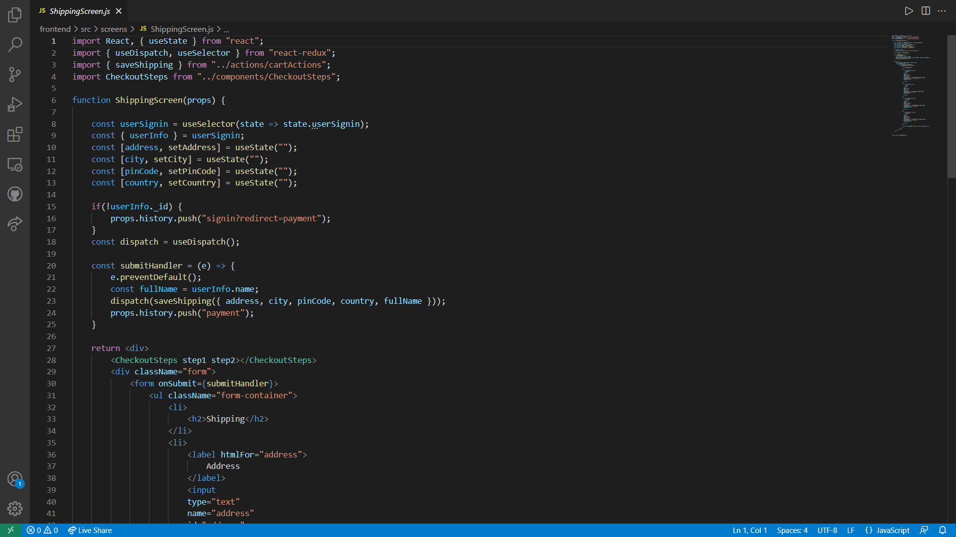
ShippingScreen Code

Slide 22
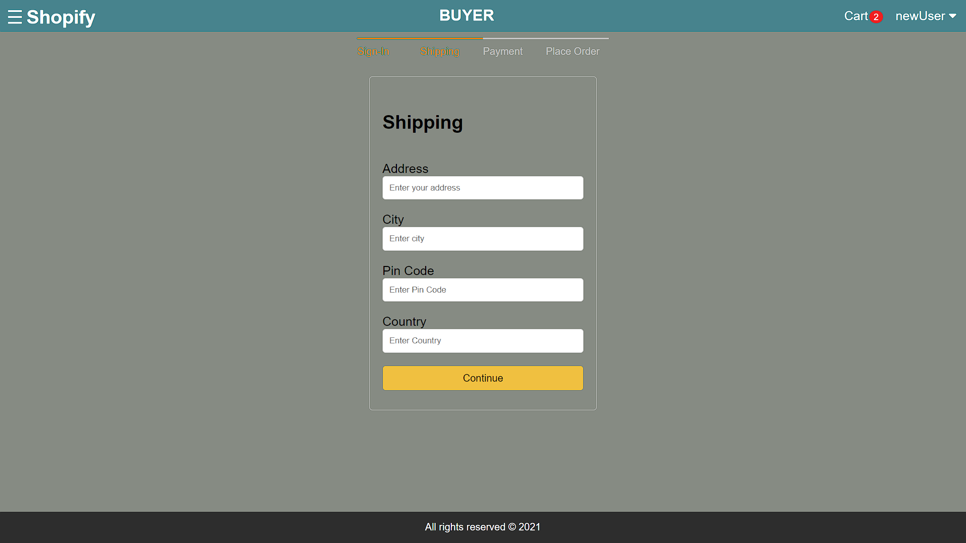
ShippingScreen ScreenShot

Slide 23
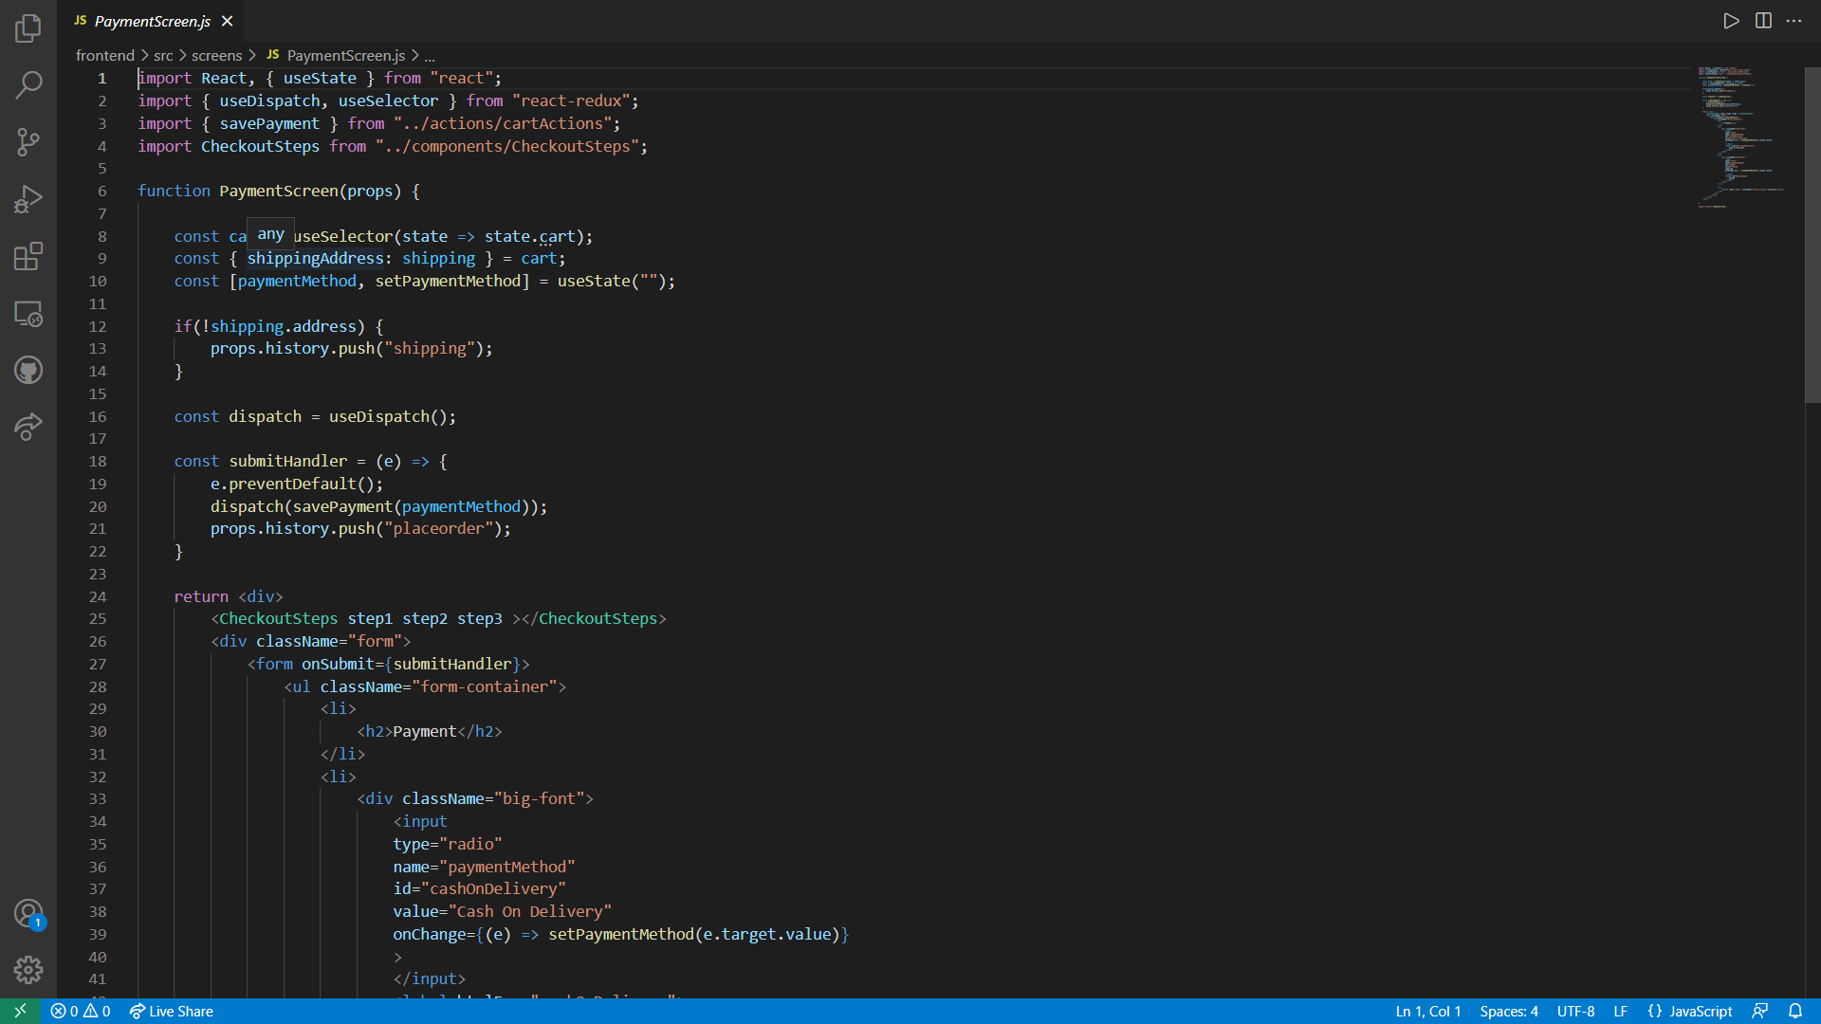
PaymentScreen Code

Slide 24
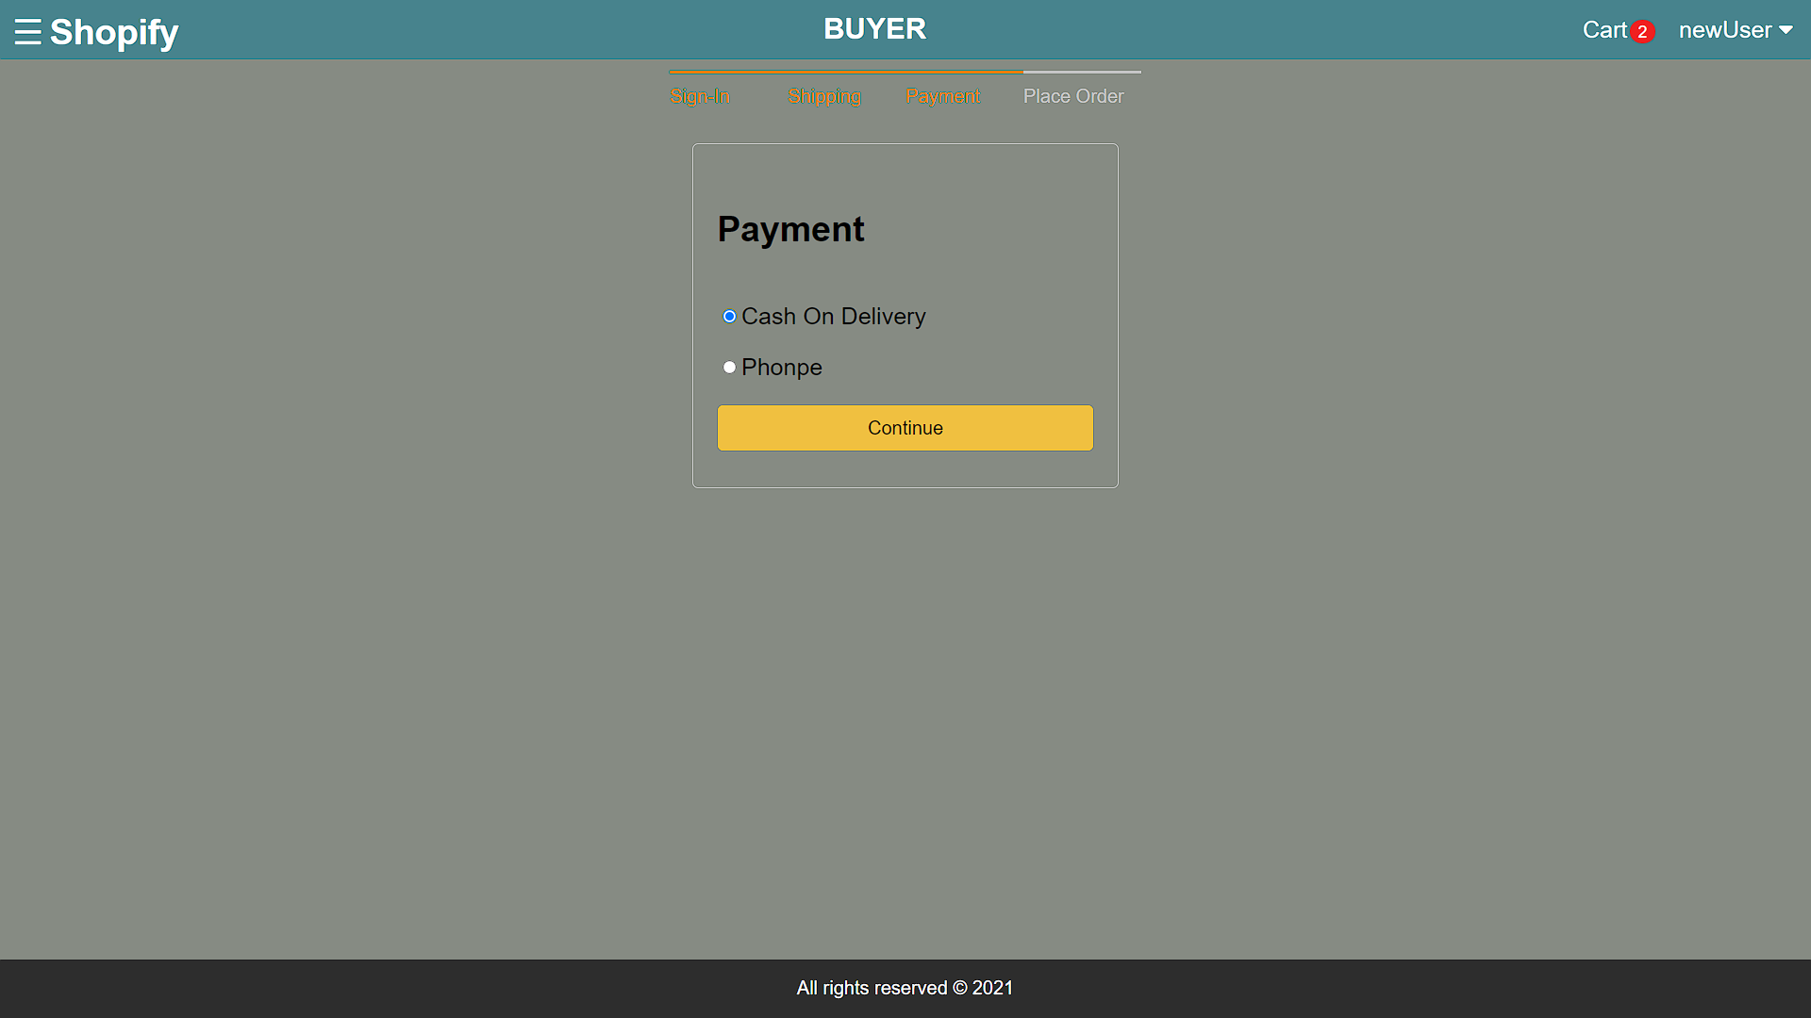
PaymentScreen ScreenShot

Slide 25
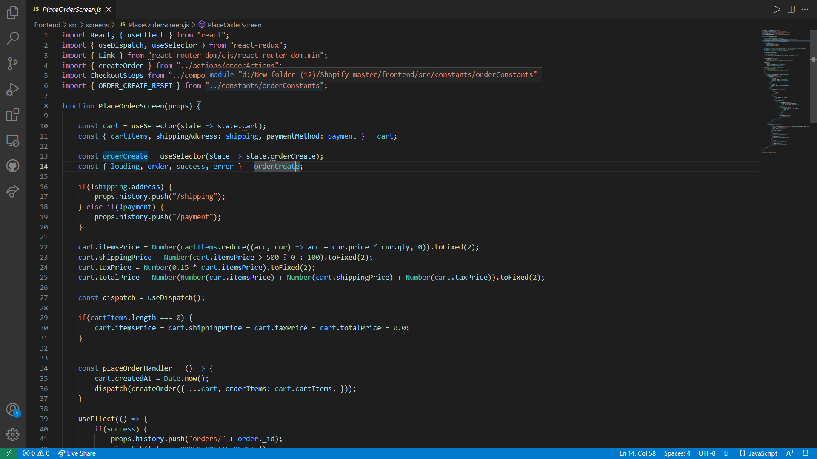
PlaceOrderScreen Code

Slide 26
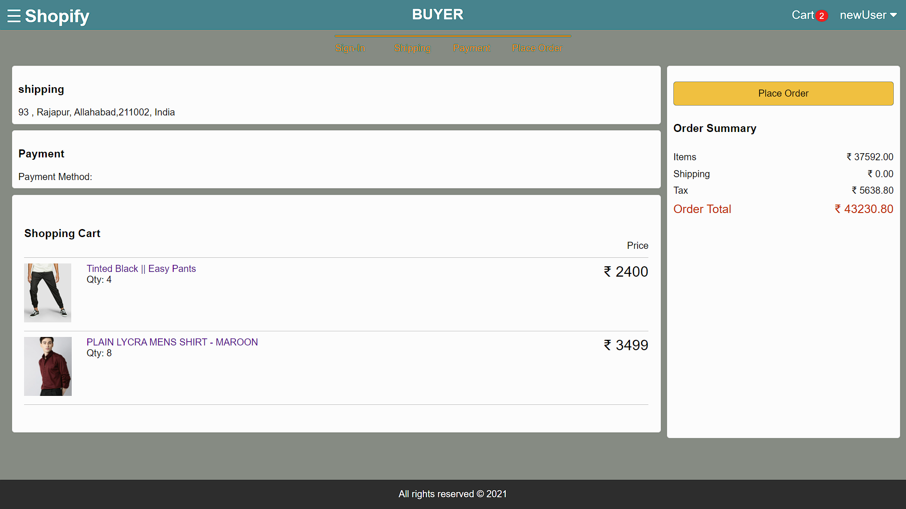
PlaceOrderScreen ScreenShot

Slide 27
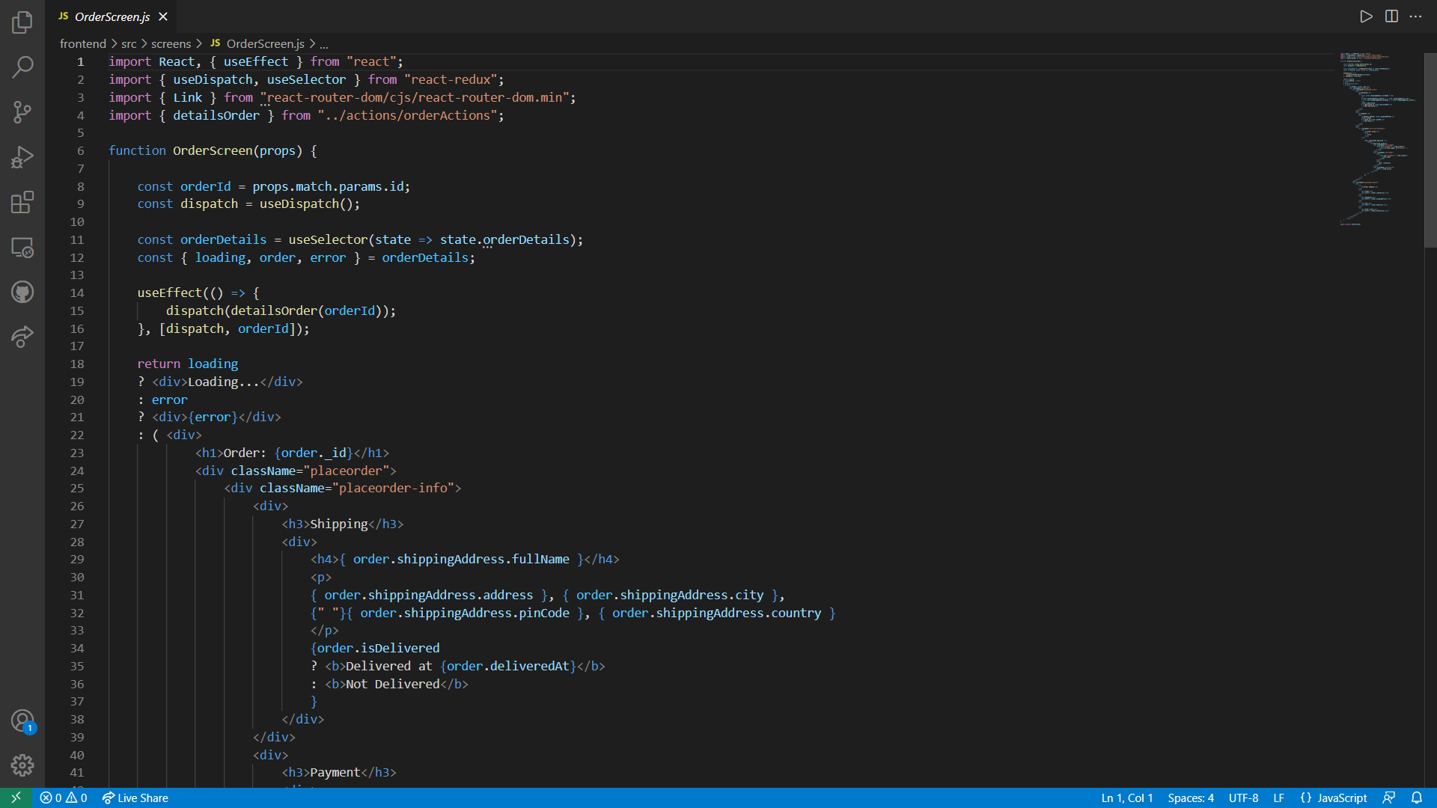
OrderScreen Code

Slide 28
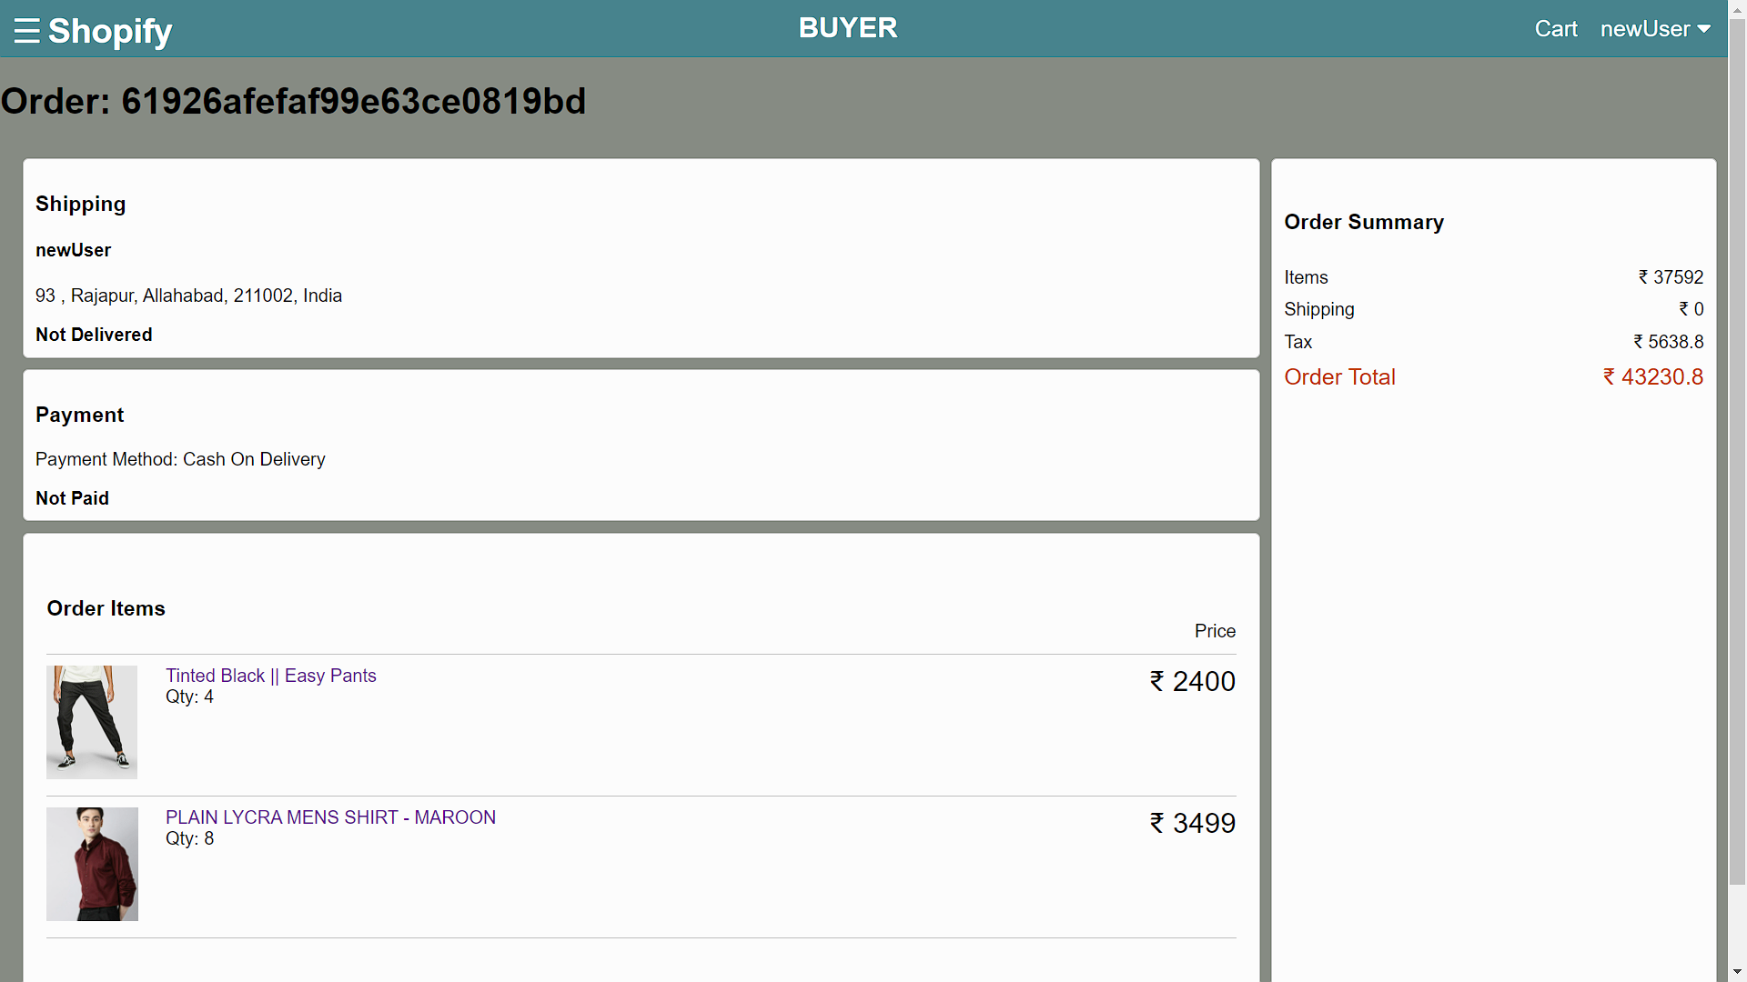
OrderScreen ScreenShot

Slide 29
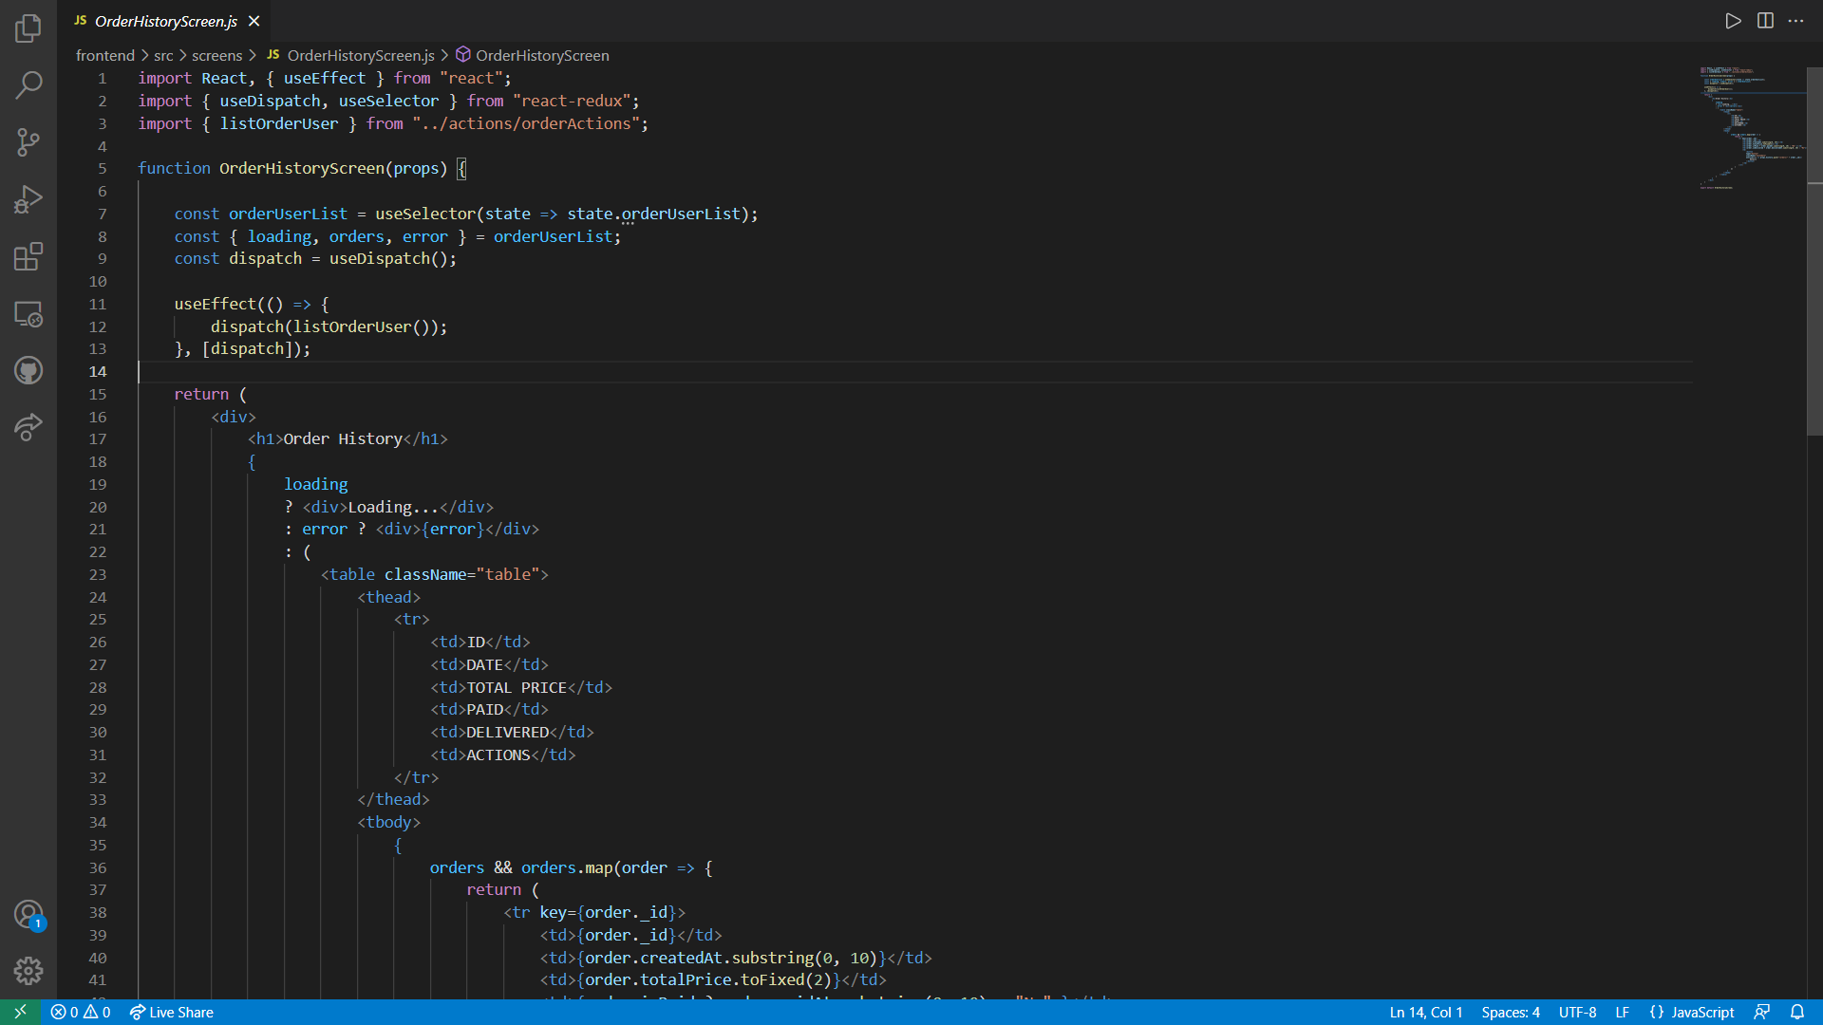
OrderHistoryScreen ScreenShot

Slide 30
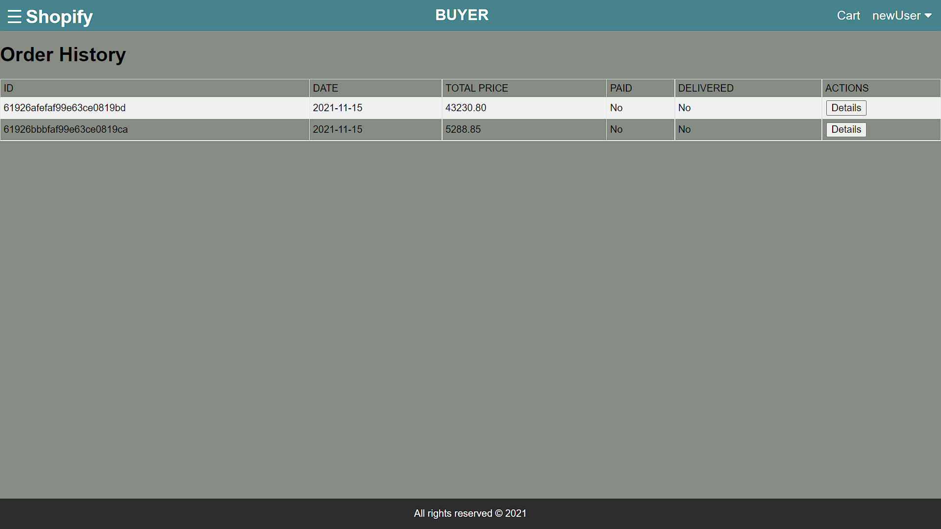
OrderHistoryScreen ScreenShot

Slide 31
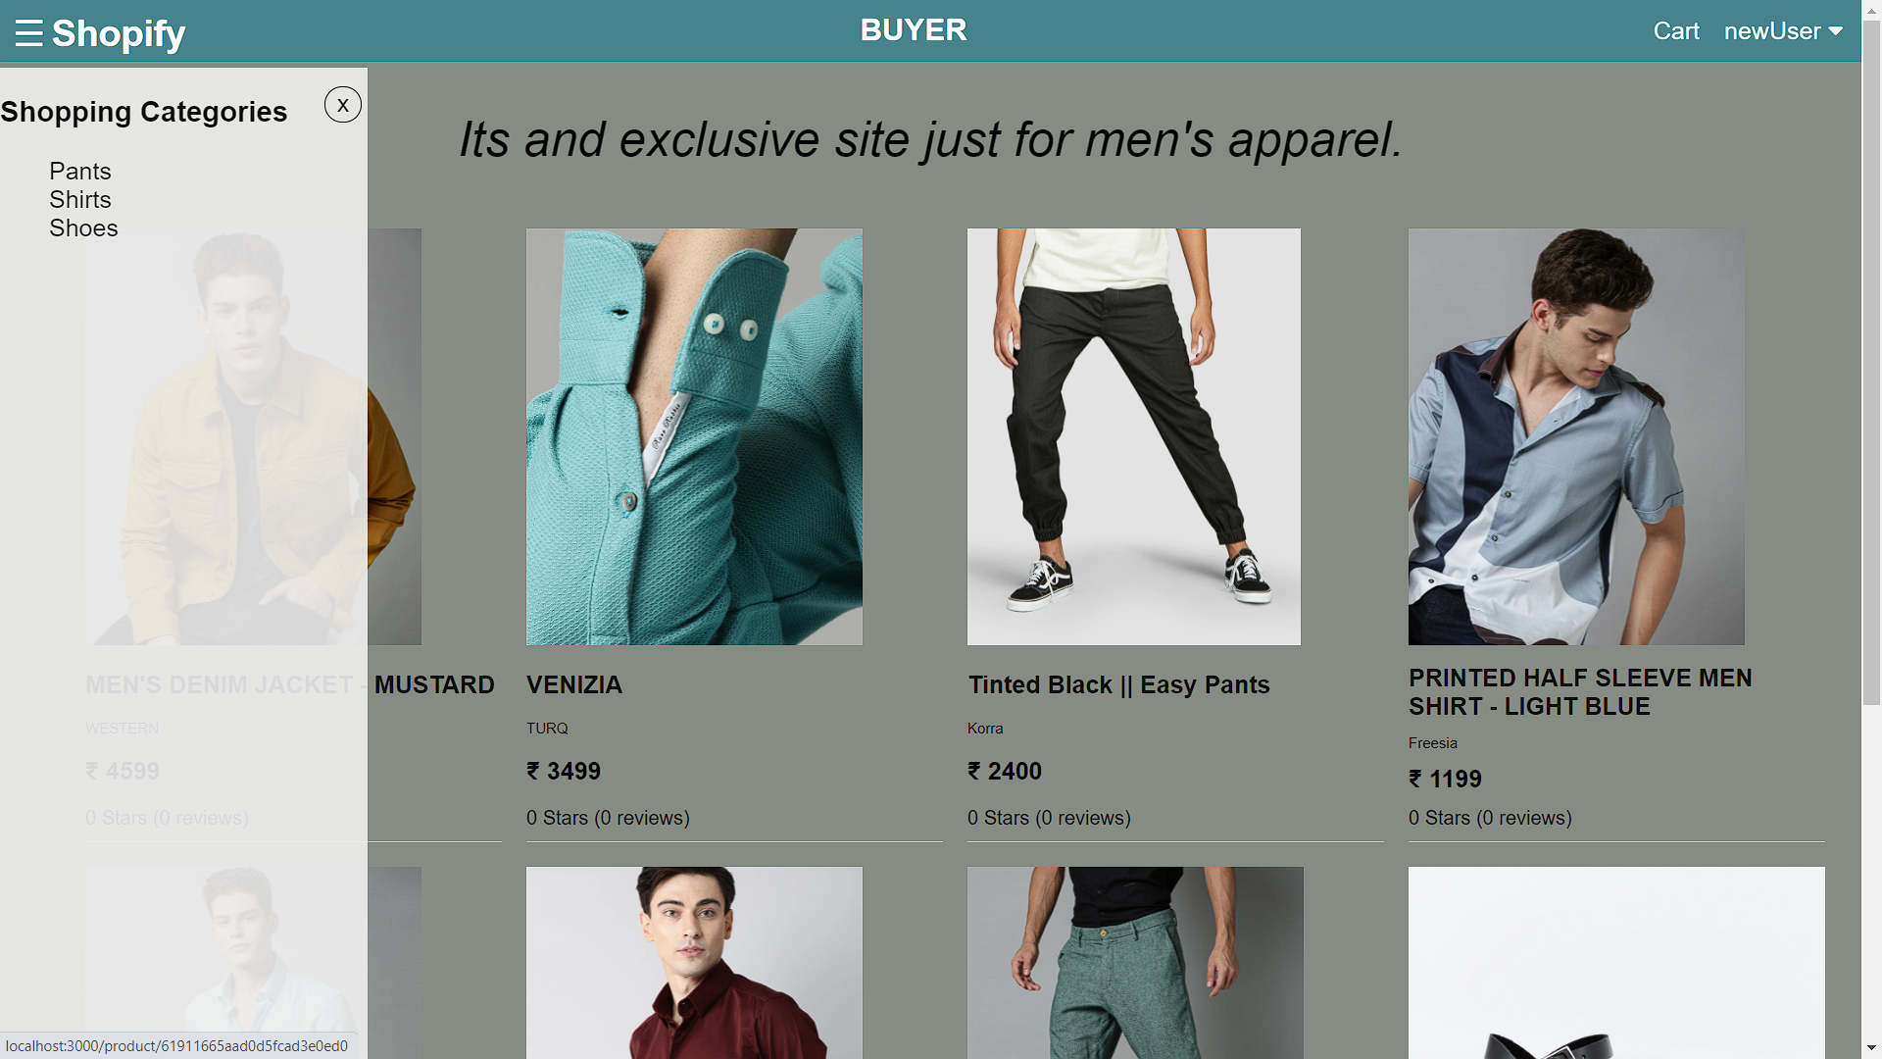
Category ScreenShot

Slide 32
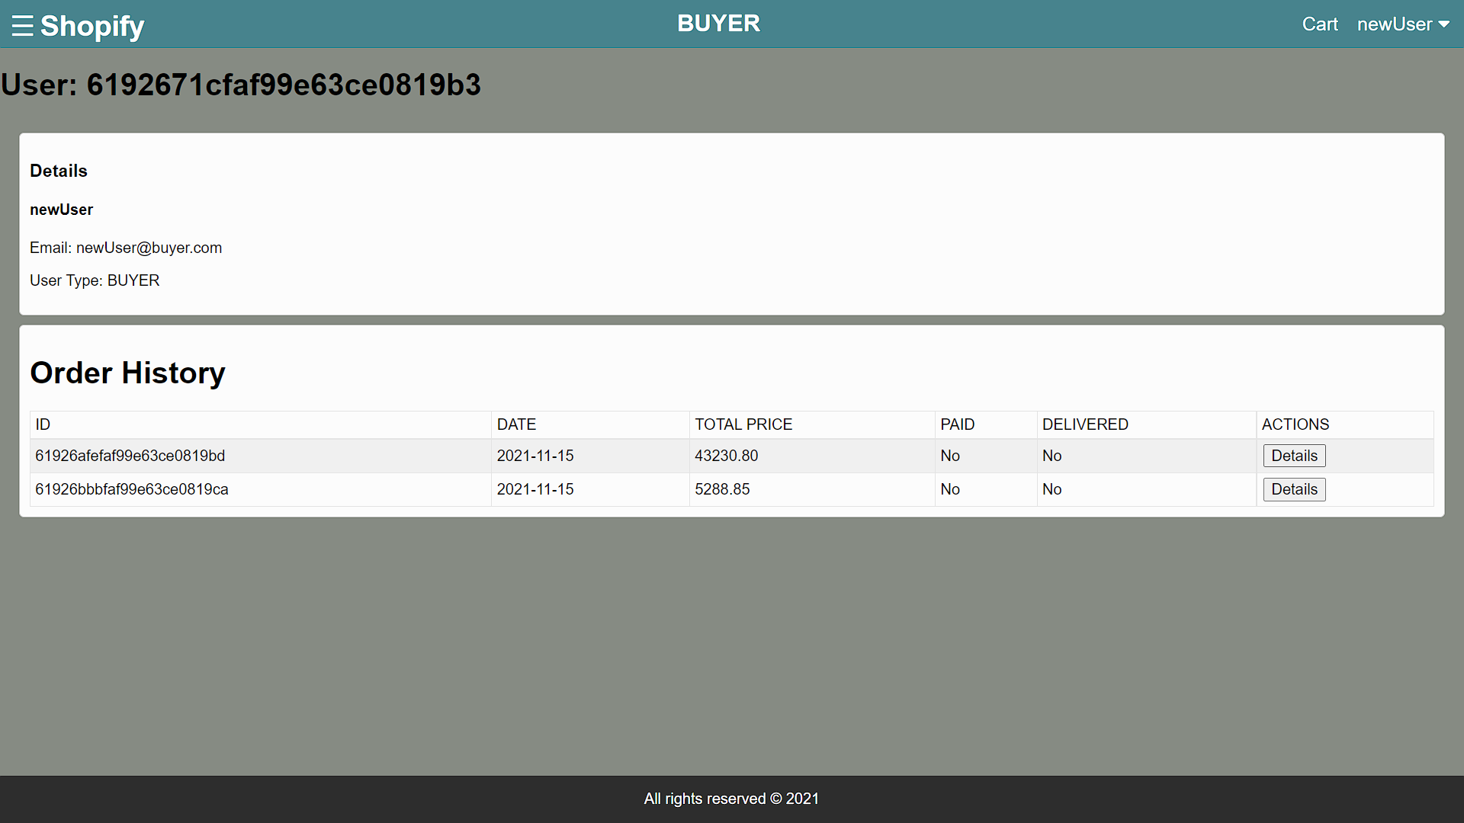
Dashboard ScreenShot

Slide 33
UserType -Buyer ScreenShot

Slide 34
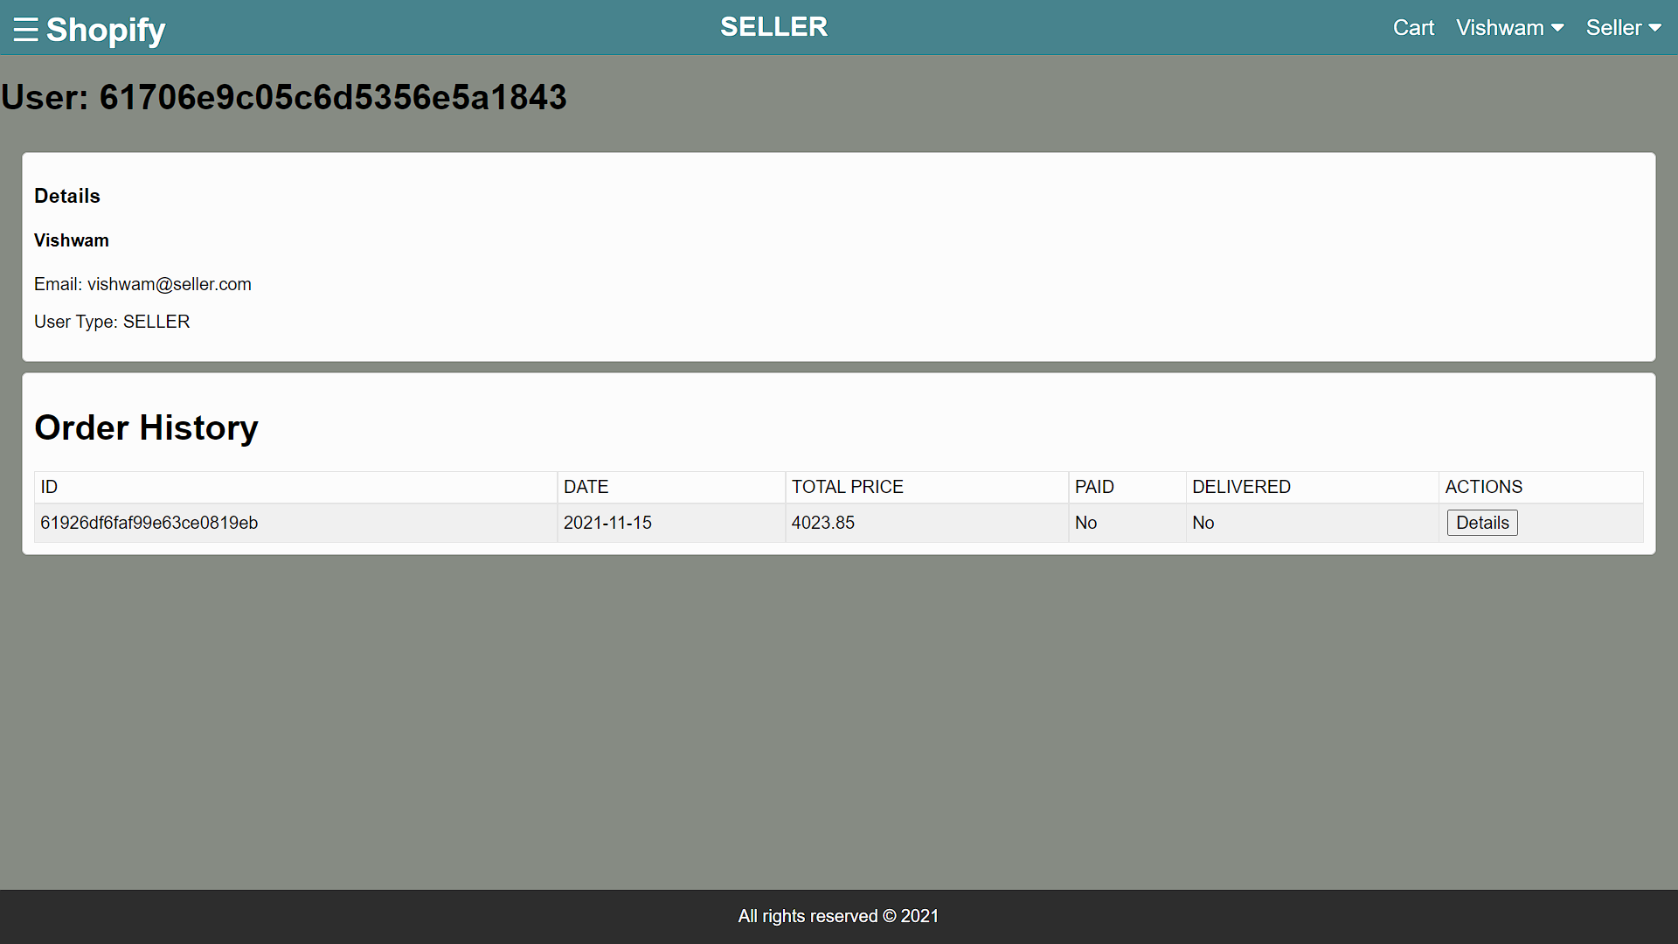
UserType – Seller ScreenShot

Slide 35
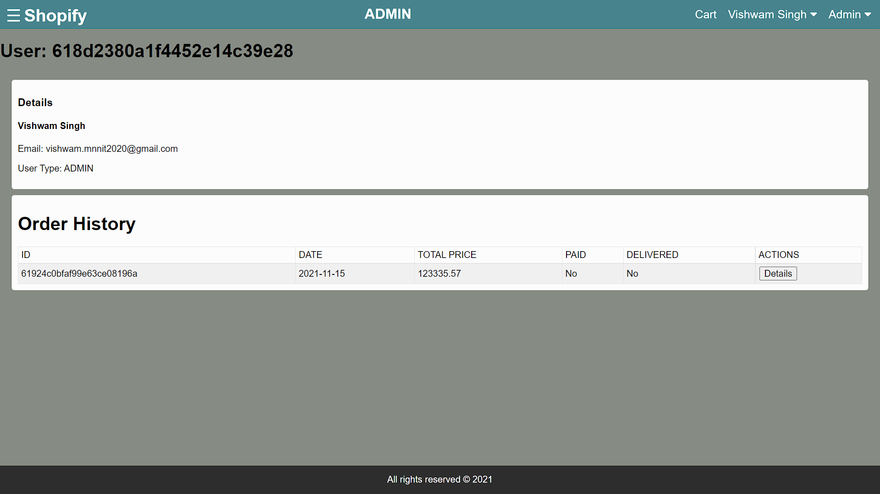
UserType – Admin ScreenShot

Slide 36
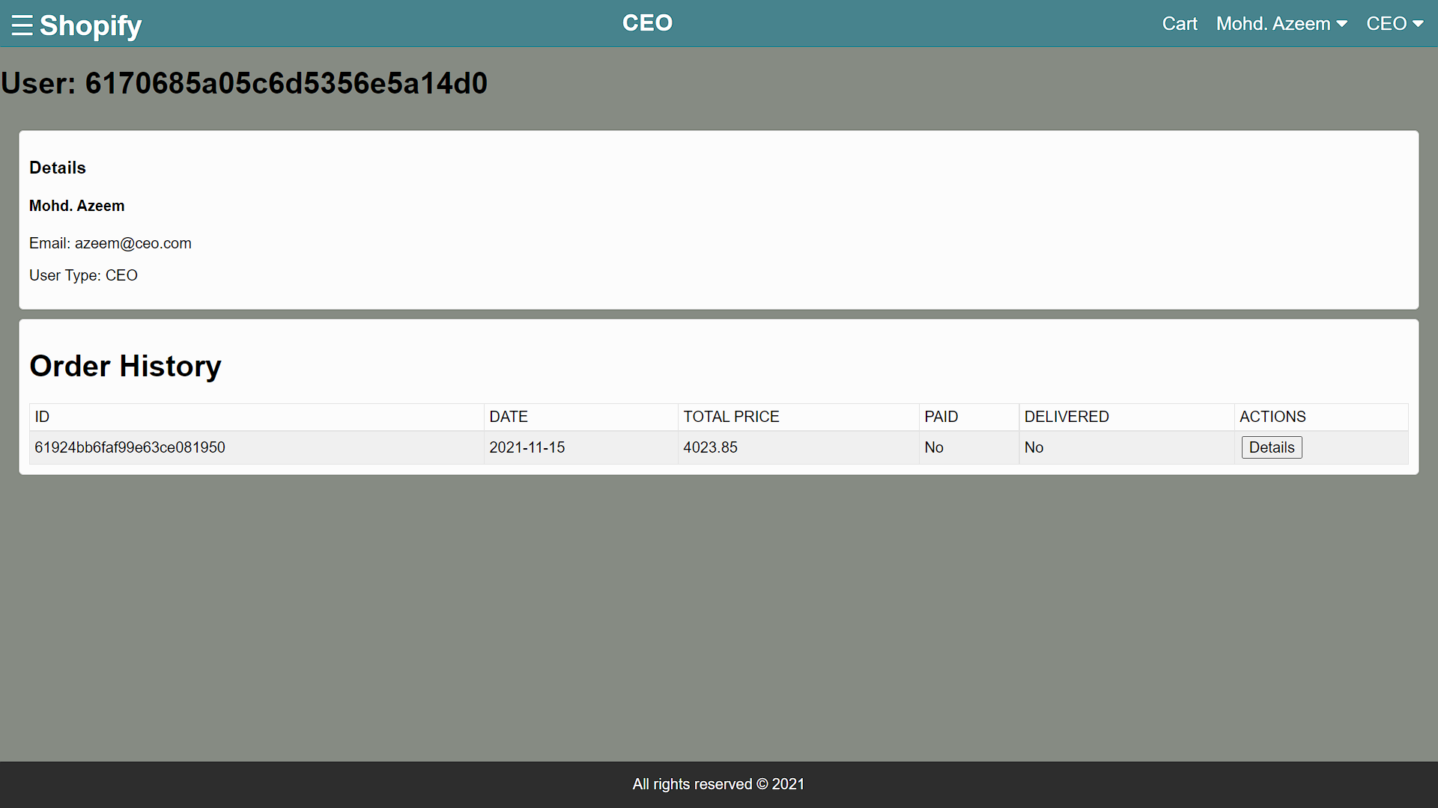
UserType – CEO ScreenShot

Slide 37
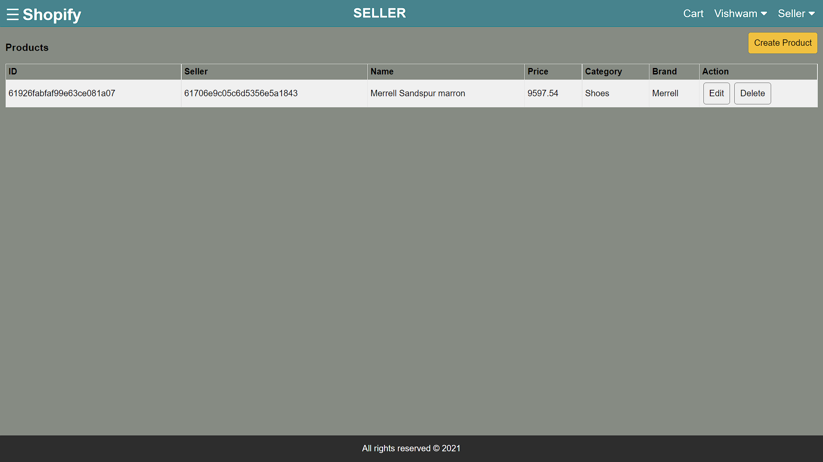
Seller View of Products

Slide 38
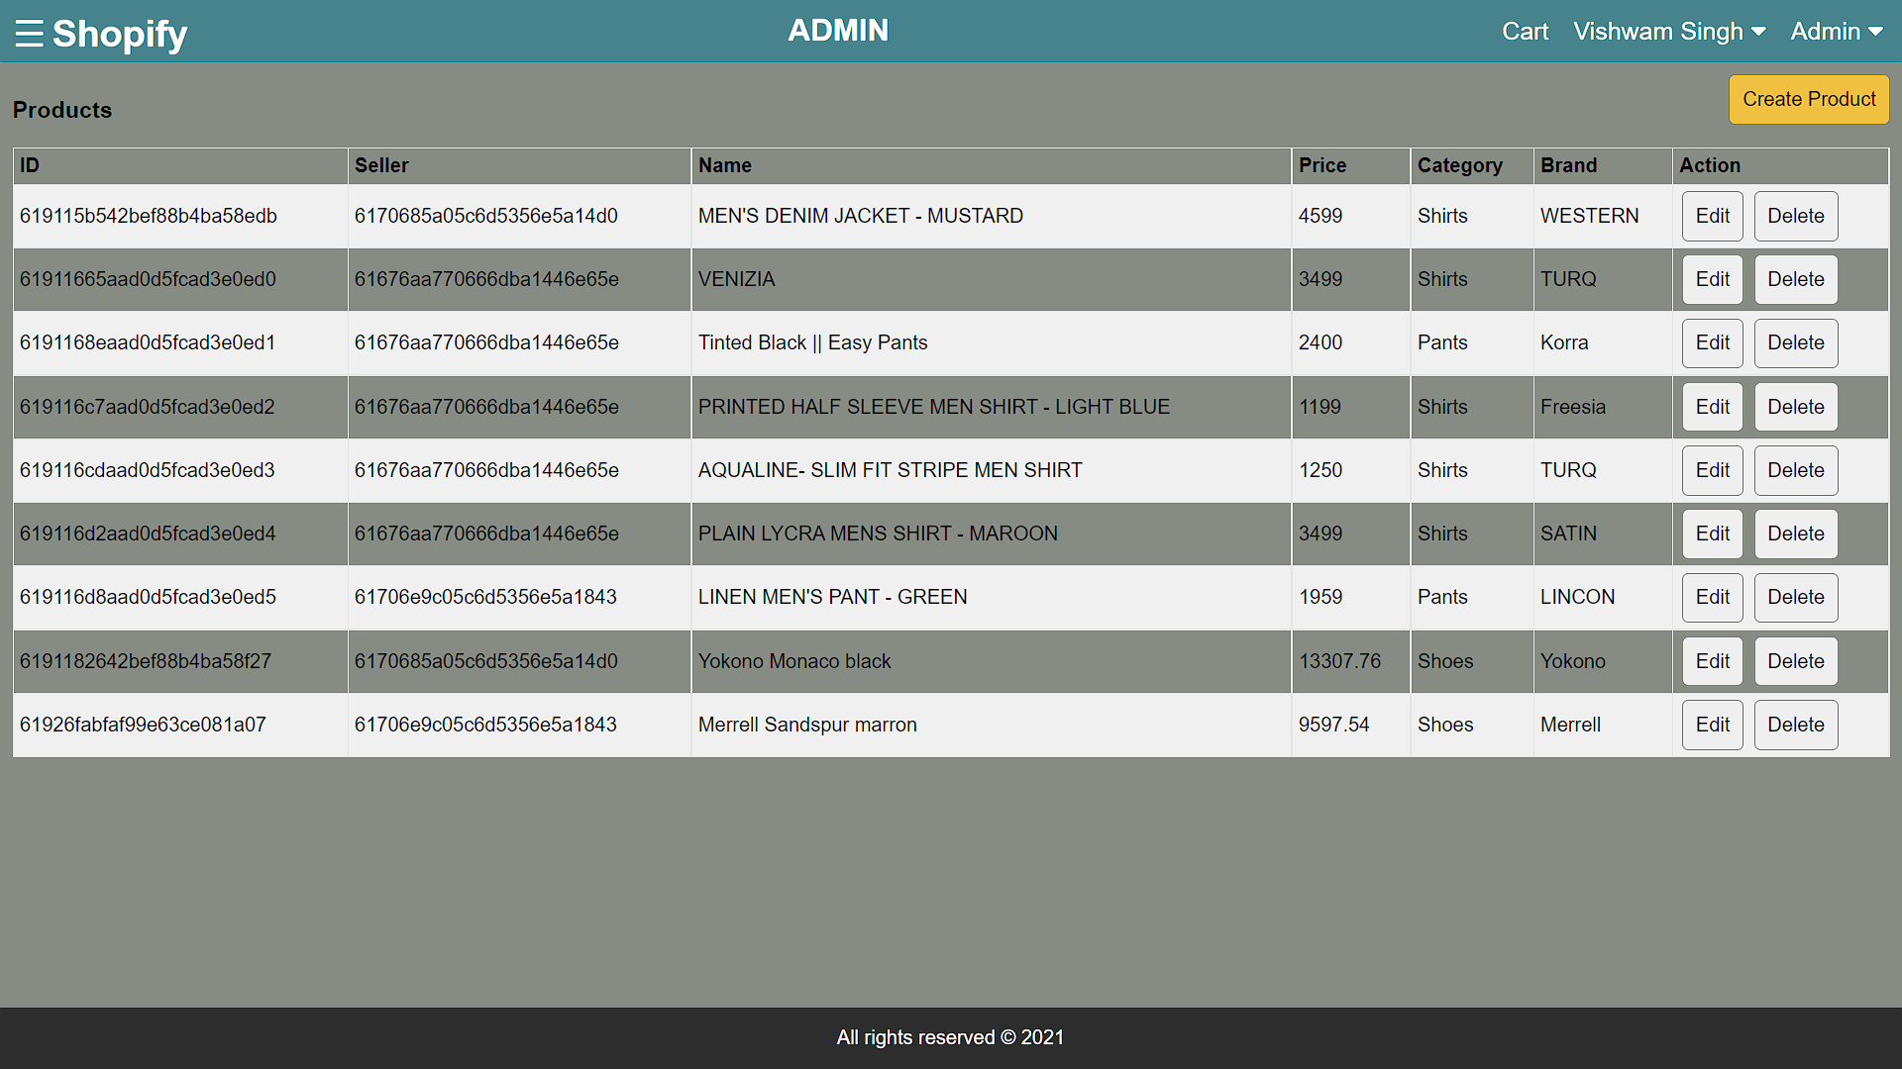
Admin View of Products

Slide 39
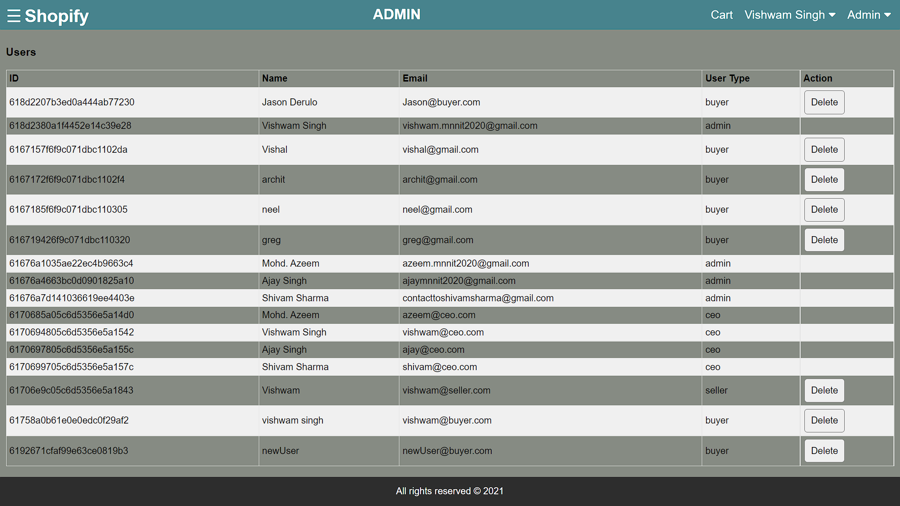
Admin View of Users

Slide 40
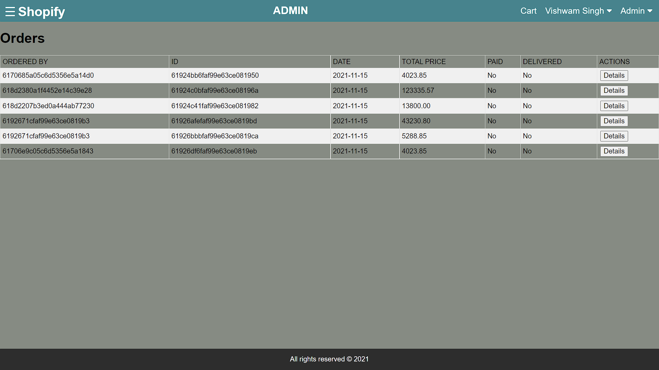
Admin View of Orders

Slide 41

CEO View of Products

Slide 42
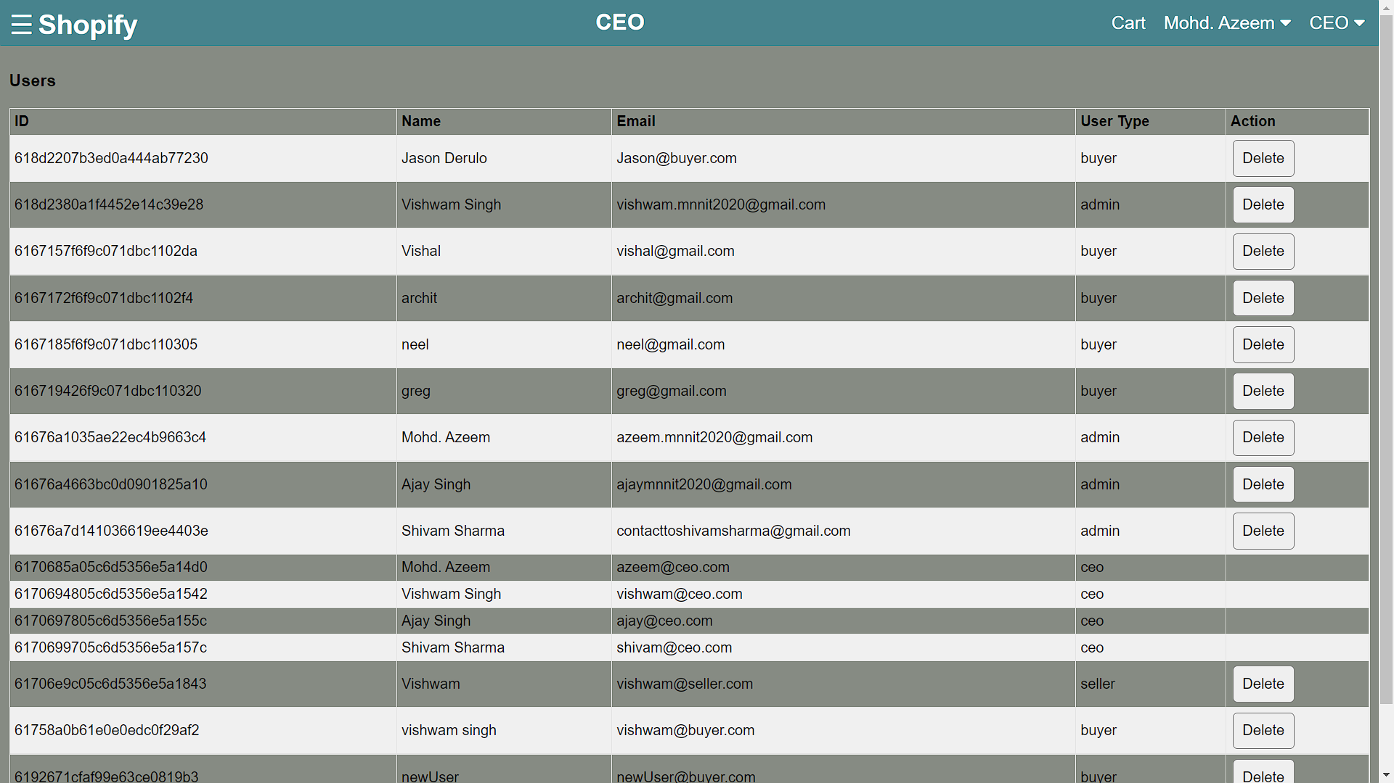
CEO View of Users

Slide 43
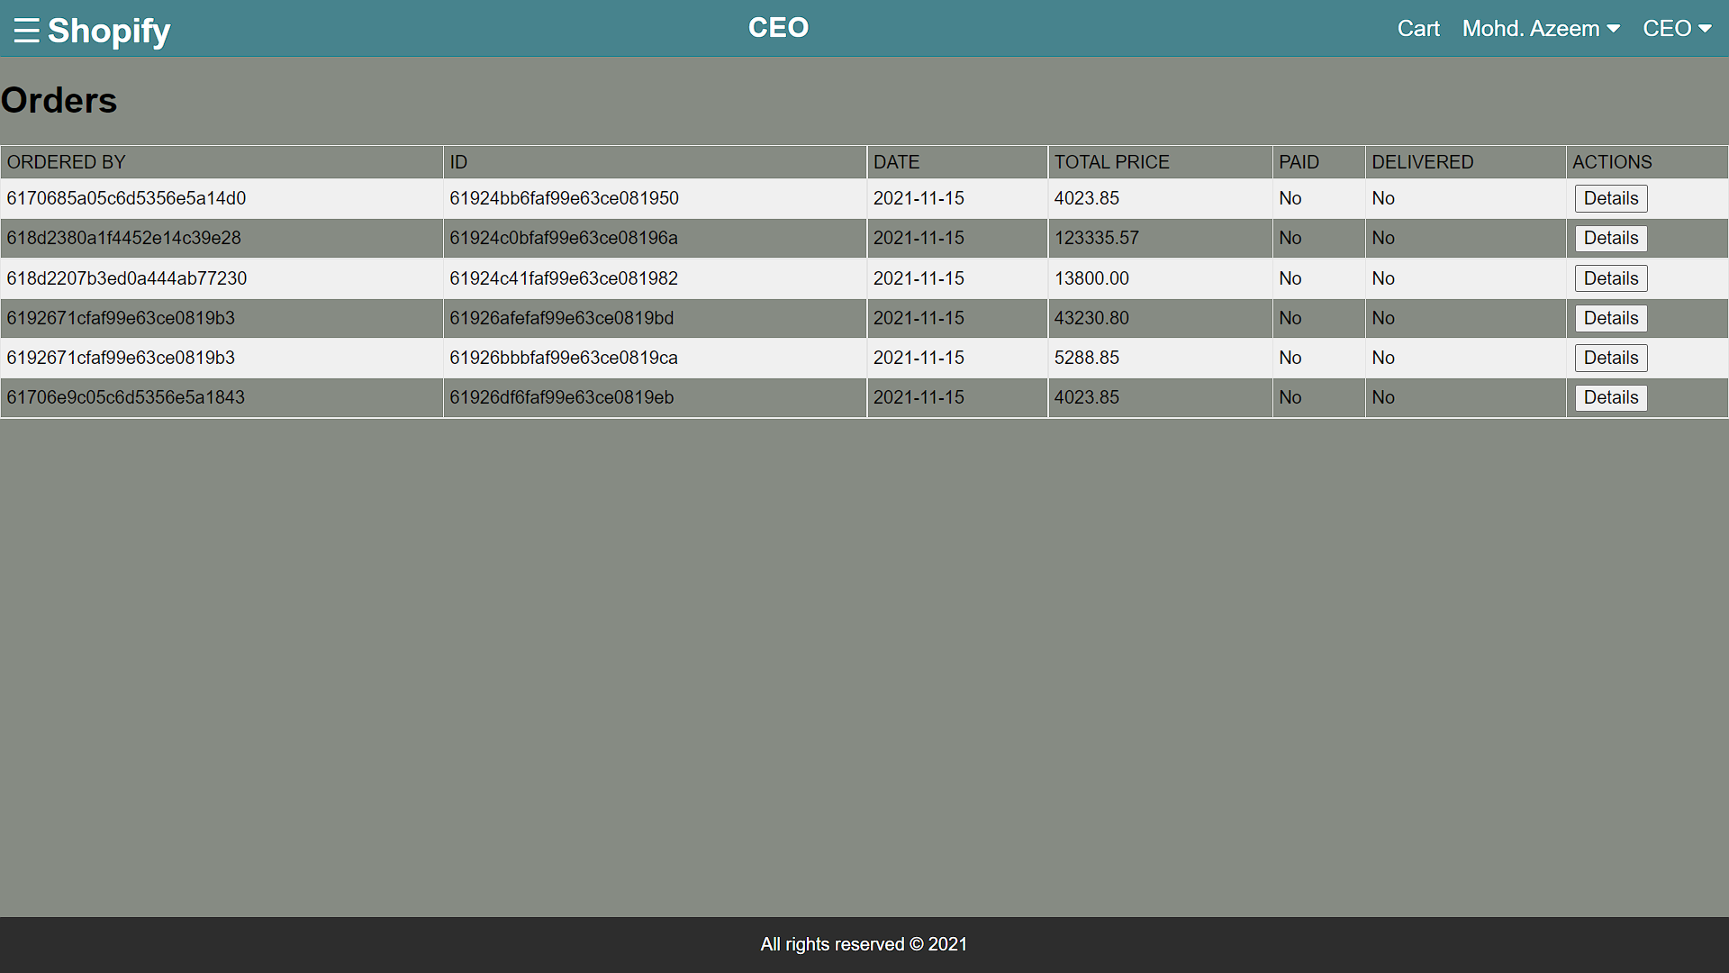
CEO View of Orders

Slide 44
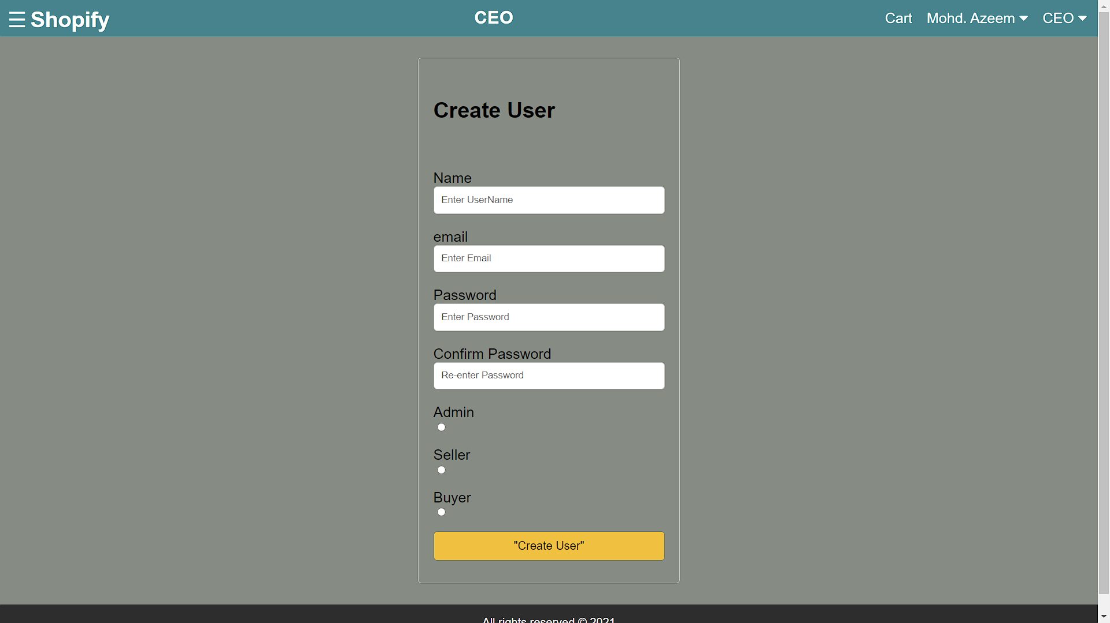
CreateUser Screen Shot (Authority -CEO)

Slide 45
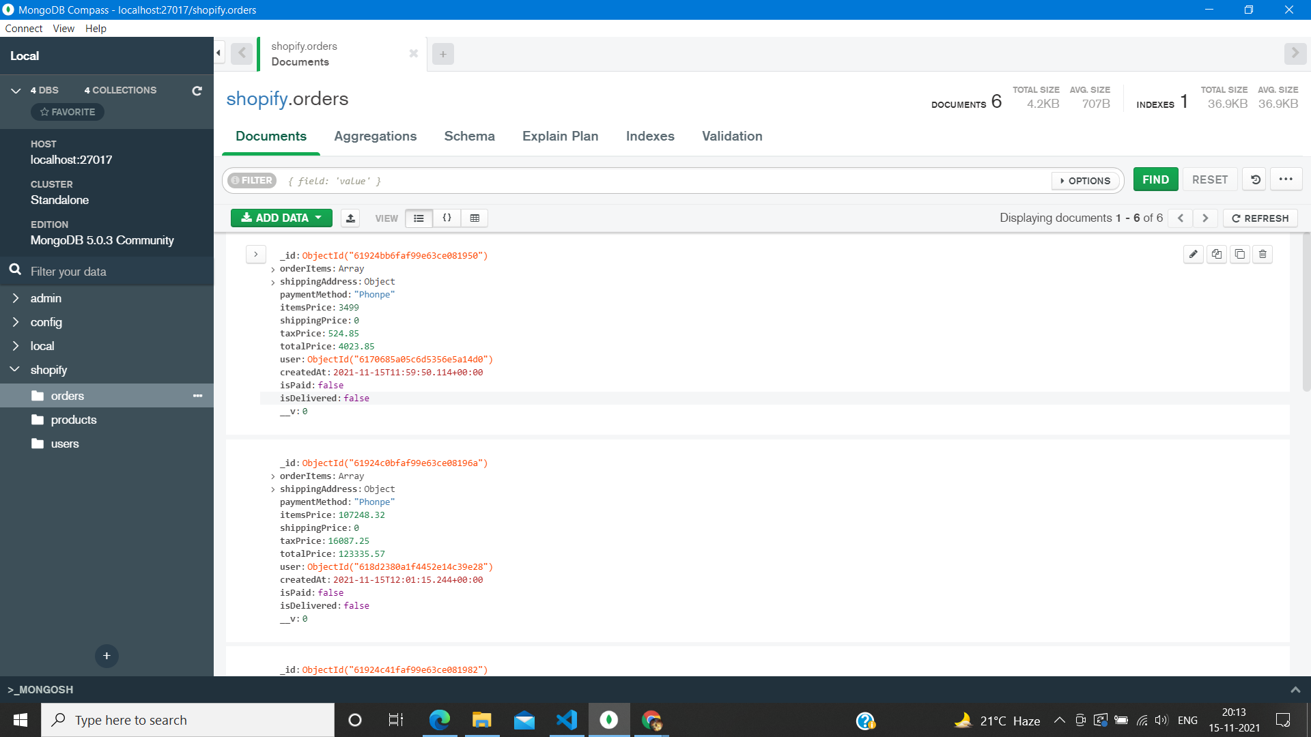
ScreenShot of Order Documents - MongoDB

Slide 46
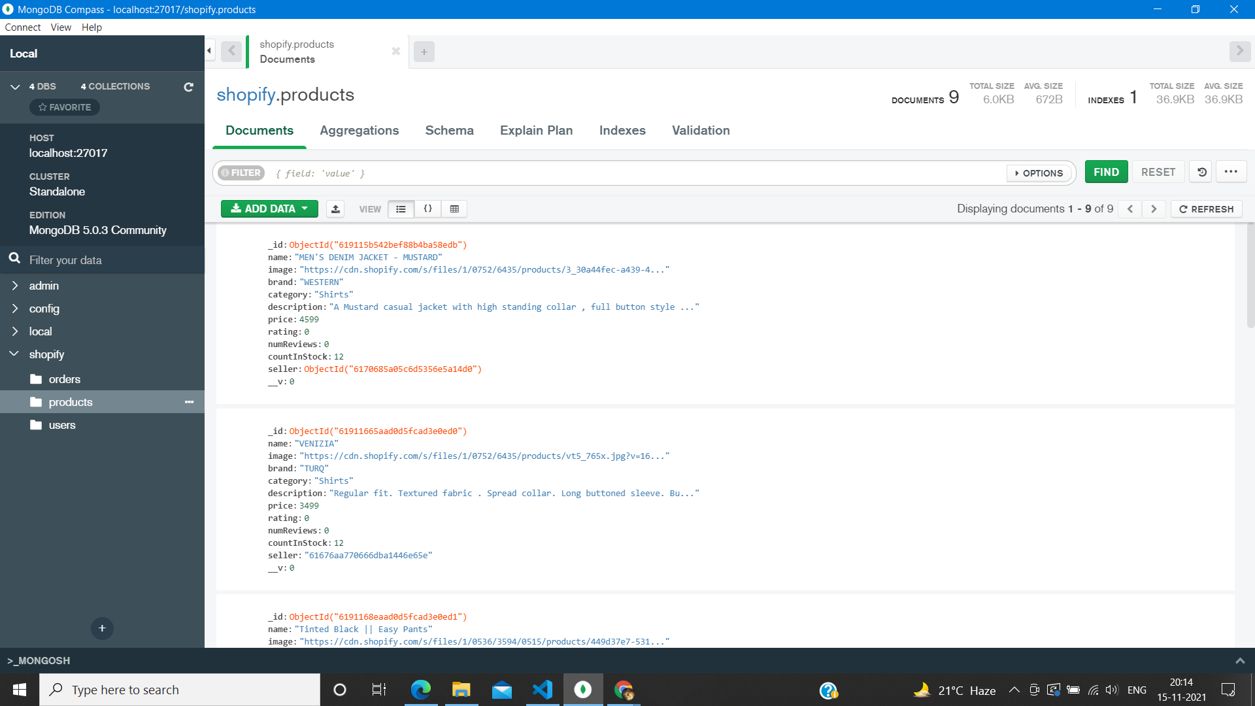
ScreenShot of Products Documents - MongoDB

Slide 47
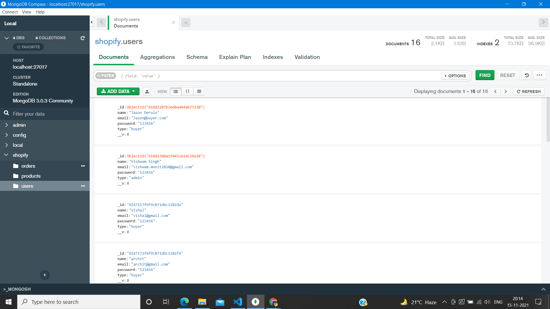
ScreenShot of Users Documents - MongoDB

Slide 48
Conclusion
This project enables one think about the immense possibility in the field of POS integration and trading online.
E-Commerce websites are the future of technology.
E-commerce is powered by the internet, where customers can access an online store to browse through, and place orders for products or services via their own devices.
Today there are so many websites where various e-commerce methods are practiced such as Amazon, Flipkart.
Subscription facilities have grown in recent years due to Covid-virus.
Trading using crypto currency has a lot of growth with high risks involved, but people still do trading using crypto currency.

Slide 49
Result Analysis
The requirements of all the assignments were successfully met and the final product still lacks certain web features such as POS integration and order delivery status change.
Features Implemented :
User can view his profile and update his/her information.
Sellers can add and update products.
Admin can add and update products and add and delete sellers or buyers.
CEOs can add and update products and add and delete sellers or buyers or admins.
Change the quantity of products in the checkout screen.

Slide 50
Result Analysis
Features to be Implemented :
POS integration.
Implementation of payment through payment gateways such as paypal and PhonePe.
Updation of delivery and payment status.
Adding more categories and subcategories to the apparels for sale.
Adding api automation for data fetch.
Deploying on a real web server.

Slide 51
References
NodeJs
ExpressJs
ReactJs
ReduxJs
React Router Dom
Babel
Shopify.in

Slide 52

Thank You

